Slide 1
TOPIC:
Bed Mobility, Transfers and Ambulation After Stroke

Slide 2
Bed Mobility, Transfers and Ambulation After Stroke
A stroke can cause weakness, altered muscle tone, loss of coordination, changes in sensation and decreased body awareness
Careful handling of the person during movement can improve safety and comfort
Notes:
A stroke can cause weakness, altered muscle tone, loss of coordination, changes in sensation and decreased body awareness. These can impact a person’s ability to move
Careful handling of the person during movement can improve safety and comfort.

Slide 3
Bed Mobility, Transfers and Ambulation After Stroke
What you should know:
The safety and success of any mobility activity depends on a number of factors
There are four main types of movement which include:
Bed Mobility
Transitional Movements
Transfers
Ambulation
Always protect and never pull on the affected arm when moving
Notes:
The safety and success of any mobility activity depends on a number of factors (See Smart Tips for Stroke Care – Mobility After Stroke).
There are four main types of movement which include bed mobility (e.g. rolling), transitional movements (e.g. lie to sit, sit to stand), transfers (e.g. pivot or stepping to move between surfaces such as bed and chair), and ambulation (e.g. walking).
Always protect and never pull on the affected arm when moving (See Smart Tips for Stroke Care - The Hemiplegic Arm and Hand)

Slide 4
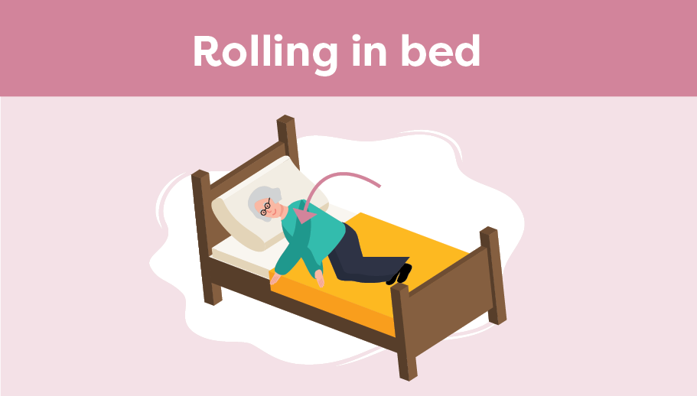
Bed Mobility, Transfers and Ambulation After Stroke
Smart Tips:
Before rolling, ask/ help the person to:
Bend their knees and place feet flat on the bed
Initiate the roll by allowing the knees to fall, turning the head, and reaching with the arm towards the direction of the roll, bringing their arm with the rest of the body
Assist the person by helping at the back of the shoulder blade and hip as needed; never pull on the affected arm
Notes:
Smart Tips –This section pertains to rolling in bed
Always follow the care plan and lift policies at your organization!
Before rolling, ask/ help the person to:
Bend their knees and place feet flat on the bed
Initiate the roll by allowing the knees to fall, turning the head, and reaching with the arm towards the direction of the roll, bringing their arm with the rest of the body
Assist the person by helping at the back of the shoulder blade and hip as needed, never pull on the affected arm
Other bed mobility tasks include shifting upwards or side to side in bed.
All of these movements may require the use of a draw sheet and an additional helper.

Slide 5
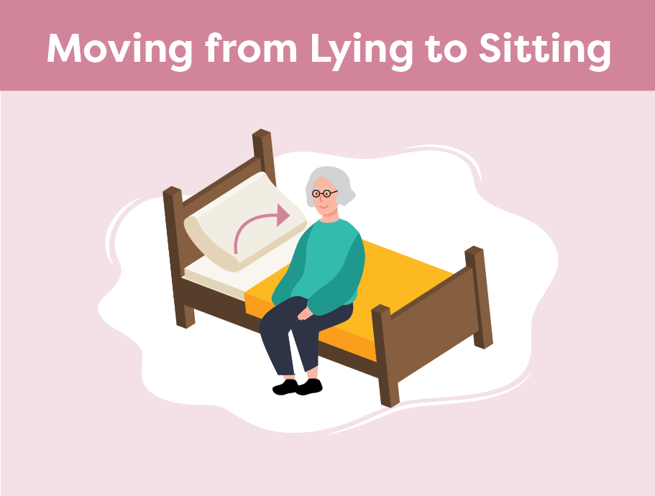
Bed Mobility, Transfers and Ambulation After Stroke
Once on their side, ask/ help the person to:
Bring their feet over the edge of the bed by moving their knees up towards their chest
Push up with the bottom arm to sit up. If assistance is needed, place one hand underneath the bottom ribs near the shoulder blade, and one hand on the upper hip
Once sitting safely, lower the height of bed if possible, to allow feet to be in contact with the floor
Notes:
Smart Tips- this section pertains to moving from lying to sitting:
Once on their side, ask the person (or help them) to:
Bring their feet over the edge of the bed by moving their knees up towards their chest
Push up with the bottom arm to sit up. If assistance is needed, place one hand underneath the bottom ribs near the shoulder blade, and one hand on the upper hip.
Never pull on the person’s arm
Once sitting safely, lower the height of bed if possible to allow feet to be in contact with the floor

Slide 6
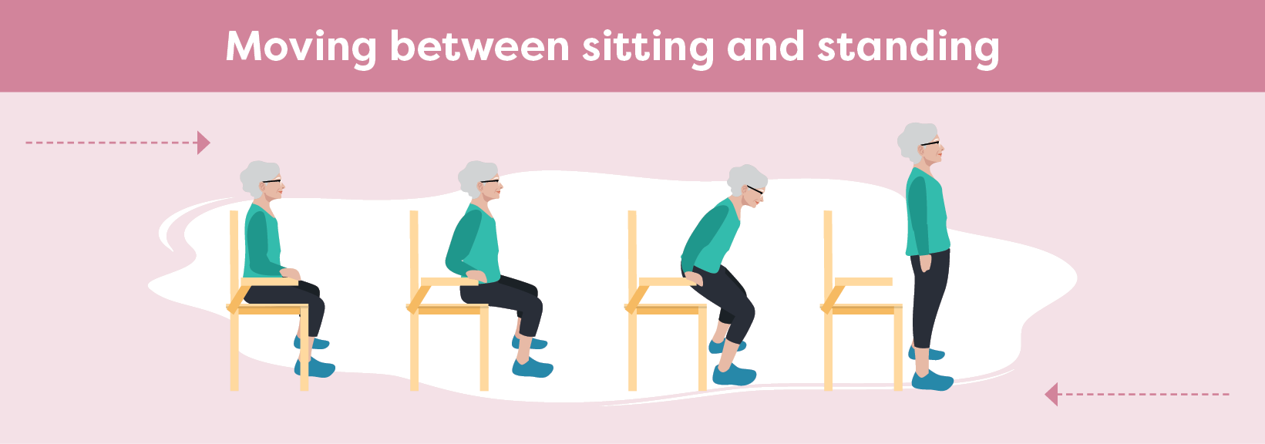
Bed Mobility, Transfers and Ambulation After Stroke
Sit to Stand
Stand on the persons affected side
Ask/help the person to:
Shift hips towards front edge of the sitting surface
Place feet shoulder width apart, with heels under the knees
Sit up tall and bend forward at the hips while looking ahead
Push up from the bed with both hands, if able- do not pull on walker
Push through both legs with weight equally distributed
Notes:
This section pertains to Moving from Sitting to Standing:
Stand on the person’s affected side
Ask the person (or help them) to:
Shift their hips forward towards the edge of the sitting surface
Position the feet shoulder width apart, with the heels on the floor under the knees
Sit up tall, then bend forward at the hips while looking forward (not at the floor) with back straight
Push up from the bed with both hands, if able. DO NOT allow the person to pull on the walker to stand (or any other person/item/gait aid)
Push through their legs with their weight equally distributed on both legs. If assistance is needed, assist under the buttocks

Slide 7
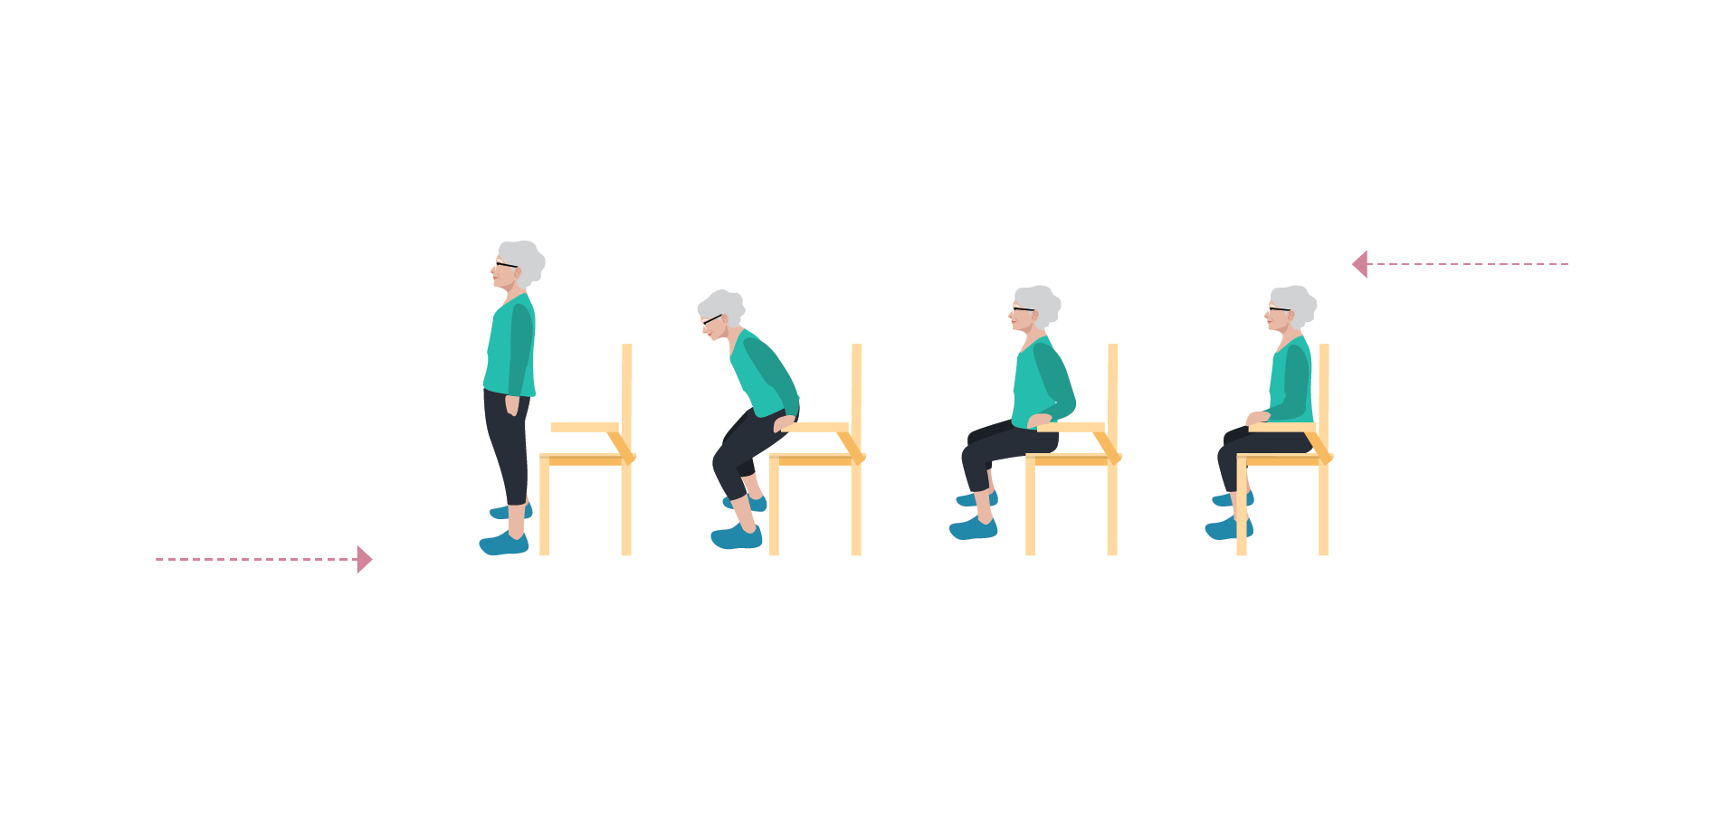
Bed Mobility, Transfers and Ambulation After Stroke
Stand to Sit
Stand on the persons affected side
Ask/help the person to:
Before sitting, ensure the back of their legs are touching the sitting surface
Reach back to place their hand(s) on armrests or the sitting surface
Bend hips then knees to lower themselves slowly
Shift their hips back on the sitting surface
Notes:
This section pertains to Moving from Standing to Sitting
Before sitting, the person should feel the back of their legs touching the edge of the sitting surface (e.g. chair, bed, etc.)
Ask the person (or help them) to:
Reach back to place their hand(s) on armrests or the sitting surface
Bend forward slightly, then bend their knees to lower themselves slowly to sitting
Shift their hips back on the sitting surface

Slide 8
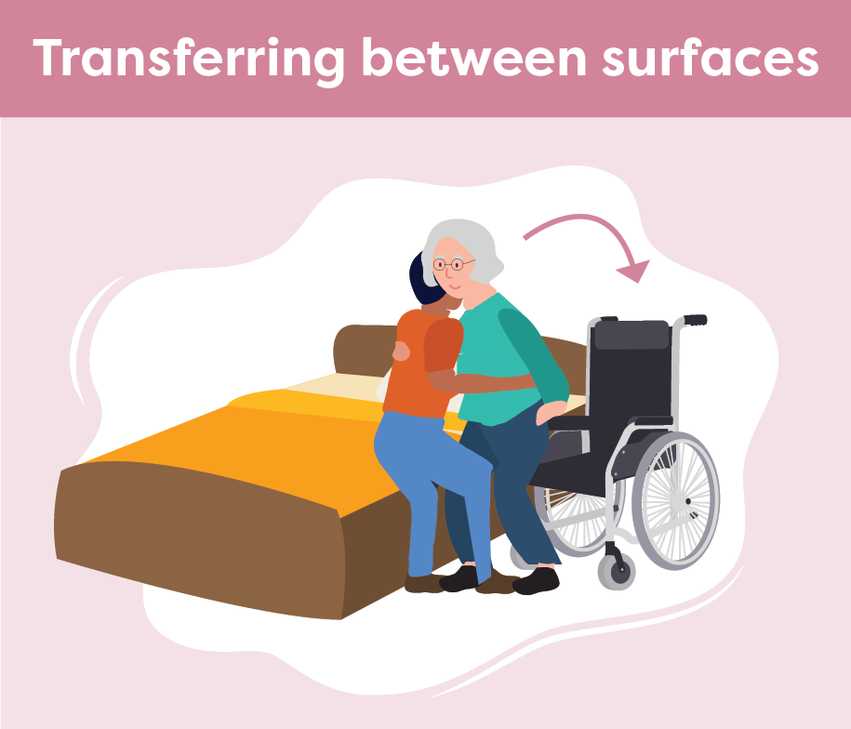
Bed Mobility, Transfers and Ambulation After Stroke
Have the person move towards their stronger side
Position the chair/ commode close to the bed
Ensure brakes are applied and arm/foot rests are removed
Ask the person to shift their hips forward to the edge of the sitting surface
Notes:
This section pertains to transferring between surfaces such as bed to chair, chair to commode, etc.:
It may be easier for the person to move towards their stronger side, if possible
Position the chair/commode as close to the bed as possible
Ensure brakes are applied and arm/foot rests are out of the way
Ask the person (or help them) shift their hips forward to the edge of the sitting surface

Slide 9
Bed Mobility, Transfers and Ambulation After Stroke
Position yourself close to the person, on their weaker side
Guide the person onto their feet and help them shift their hips from one surface to the other
Cue the person to reach towards the surface they are transferring to
Notes:
Position yourself as close to the person as possible on their weaker/affected side, without blocking their movement
Following the care plan for the individual, guide the person onto their feet and help them shift their hips from one surface to the other
Cue the person to reach towards the surface they are transferring to
If a second helper is needed, they can help guide the hips from behind (this may require demo)

Slide 10
Bed Mobility, Transfers and Ambulation After Stroke
Walking
Once standing, pause to ensure balance before walking.
If a gait aid is used, have it nearby
While walking, stand on the affected side and stay close to steady the person as needed
Encourage the person to look ahead, not at the floor
Notes:
This section pertains to support during ambulation or walking
Once standing, pause to ensure balance before walking.
If a gait aid is used, have it nearby
While walking, stand on the affected side, maintaining a close distance to steady the person as needed
Encourage the person to look up/forward to where they are going rather than at the floor
Assist the person to avoid obstacles in their path if vision or spatial awareness is affected

Slide 11
Bed Mobility, Transfers and Ambulation After Stroke
Seek extra support
Physiotherapists and Occupational Therapists are skilled in mobility and transfers. It may be helpful to involve them if there are questions or concerns
Notify the team if you notice a change in the person’s ability to transfer or ambulate
Smart Tips for Stroke Care (2023) was created by members of the Regional Stroke Networks of Ontario. This material may be shared without permission from the authors, without changes and with source credited.
Notes:
Physiotherapists and Occupational Therapists are skilled in mobility and transfers. It may be helpful to involve them if there are questions or concerns
Notify the team if you notice a change in the person’s ability to transfer or ambulate

