Slide 1
TOPIC:
Mobility After Stroke

Slide 2
Mobility After Stroke
Mobility is the ability to move one’s body (e.g. moving in or out of bed, transferring to a chair, and walking)
A stroke can cause weakness to one side of the body (hemiplegia), changes in sensation and altered muscle tone
This can impact a person’s ability to move
Regular mobility is important. It can improve function, decrease pain, enhance mood, and prevent skin breakdown and contractures
Notes:
Mobility is defined as the ability to move one’s body. Examples of mobility include moving in or out of bed, transferring to a chair, and walking.
A stroke can cause weakness to one side of the body (hemiplegia), changes in sensation and altered muscle tone.
This can impact a person’s ability to move.
Regular mobility is important. It can improve function, decrease pain, enhance mood, and prevent skin breakdown and contractures.

Slide 3
Mobility After Stroke
What you should know:
There are many factors that can impact mobility including:
The Person’s Abilities | The Environment | The Caregiver
Communication Cognition Weakness and muscle tone Balance and posture Coordination Vision and perception Sensation Mood and fatigue Motivation Pain | Lighting Equipment Space Resources available Organizational policies and procedures | Knowledge Skill Confidence Wellness Size/height Familiarity with the person
Notes:
The Person’s Abilities
Communication
Cognition
Weakness and muscle tone
Balance and posture
Coordination
Vision and perception
Sensation
Mood and fatigue
Motivation
Pain
The Environment
Lighting
Equipment
Space
Resources available
Organizational policies and procedures
The Caregiver
Knowledge
Skill
Confidence
Wellness
Size/height
Familiarity with the person

Slide 4
Mobility After Stroke
What you should know:
Practicing safe mobility can:
Prevent falls
Prevent injuries
Promote independence and active participation
Promote better health of the person with stroke
Notes:
Regularly implementing safe mobility can:
Prevent falls (~40% of all persons with stroke will fall within the first year)
Prevent injuries to the person with stroke (especially shoulder subluxation/dislocation)
Prevent injury to the caregiver
Promote independence and active participation
Promote better health of the person with stroke

Slide 5
Mobility After Stroke
General Principles of Safe Mobility
Plan for extra help if needed
Encourage the person to do as much as they can
Your goal is not to lift the person but to support them
Always follow your organization’s lift policies
Do not rush
Recognize that the person’s energy levels can change throughout the day
Notes:
Smart Tips- Always follow the care plan!
Plan for extra help if needed. Do not attempt to assist a person alone if you are unsure of what they can do. It is always better to have more help
Encourage the person to do as much as they can. This will allow the person to feel safer and more in control of the movement, and will minimize the risk of injury
Your goal in assisting with mobility is not to lift the person with stroke, but to support them in the mobility activities they can consistently and safely do. Always follow your organizations lift policies
Do not rush. Move slowly and gently. This will allow the person to participate more successfully and minimize anxiety
Recognize that the person’s energy levels can change throughout the day. This may affect their ability to mobilize, and they may require more assistance if fatigued

Slide 6
Mobility After Stroke
General Principles of Safe Mobility
Consider the person’s deficits that may impact mobility:
Weakness
Which side has been affected by the stroke?
Ability to move each limb?
Sensation
Can they feel their arm/leg?
Do they know where it is positioned?
Pain?
Muscle Tone
Is the limb stiff and difficult to move or is it limp and floppy?
Notes:
This slide is optional
Smart Tips- Always follow the care plan!
Consider the person’s deficits that may impact mobility
For example:
Weakness
•Which side has been affected by the stroke?
•Ability to move each limb?
Sensation
•Can they feel their arm/leg?
•Do they know where it is positioned?
•Pain?
Muscle Tone
•Is the limb stiff and difficult to move or is it limp and floppy?

Slide 7
Mobility After Stroke
General Principles of Safe Mobility
Consider the person’s deficits that may impact mobility:
Balance
Can they sit on their own?
Can they stand without assistance?
Do they stand on both feet?
Posture
Can they sit and stand upright?
Do they push themselves over
Notes:
This slide is optional
Smart Tips- Always follow the care plan!
Consider the person’s deficits that may impact mobility
For example:
Balance
Can they sit on their own?
Can they stand without assistance?
Do they stand on both feet?
Posture
Can they sit and stand upright?
Do they push themselves over

Slide 8
Mobility After Stroke
General Principles of Safe Mobility
Consider the person’s deficits that may impact mobility:
Perception
Do they neglect one side?
Cognition
Are they alert?
Are they able to learn?
Can they maintain their attention?
Notes:
This slide is optional
Smart Tips- Always follow the care plan!
Consider the person’s deficits that may impact mobility
Perception
Do they neglect one side?
Cognition
Are they alert?
Are they able to learn?
Can they maintain their attention?

Slide 9
Mobility After Stroke
General Principles of Safe Mobility
Consider the person’s deficits that may impact mobility:
Communication
Can they understand language and follow instructions?
Can they speak?
Personality
Do they have a fear of moving/falling?
Are they impulsive?
Notes:
This slide is optional
Smart Tips- Always follow the care plan!
Consider the person’s deficits that may impact mobility
Communication
Can they understand language and follow instructions?
Can they speak?
Personality
Do they have a fear of moving/falling?
Are they impulsive?

Slide 10
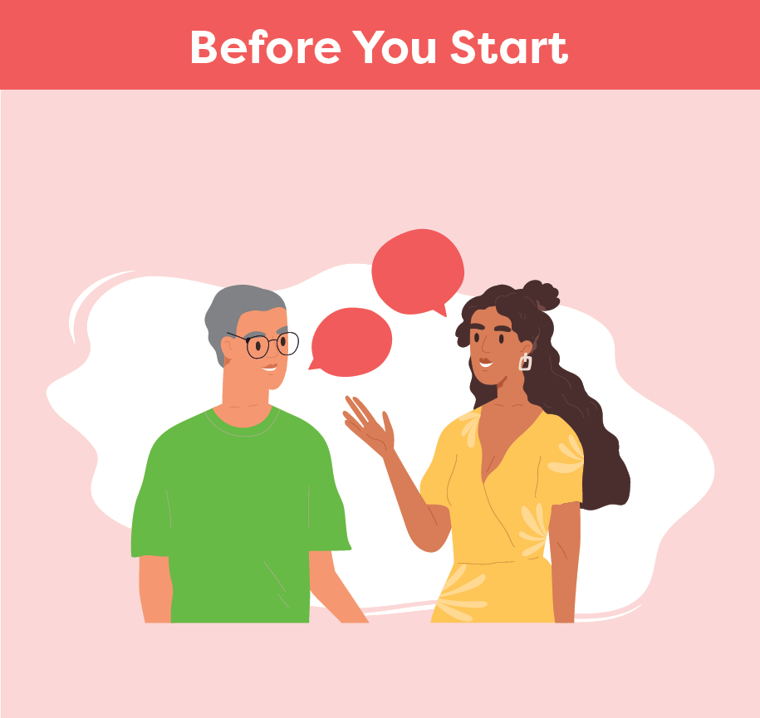
Mobility After Stroke
Smart Tips:
Prepare the environment
Communicate the plan to the person and any helpers
Be mindful of the person’s affected arm during mobility activities and handle very carefully
Notes:
Smart Tips- Always follow the care plan! This section pertains to steps you should take before you start:
Prepare the environment. Ensure the necessary equipment is nearby, the space is clear, and the lighting is adequate. (i.e. mechanical lift is working and charged, have a wheelchair close by in case patient needs to sit down).
Get to know the person/plan of care their abilities, recommendations for equipment and techniques to best assist them.
Communicate the plan to the person and any helpers before you start to move. Use simple, clear instructions, and demonstrate the action if needed. Check that they have understood
The hemiplegic shoulder can easily be injured during mobility. Be mindful of the person’s arm during mobility activities and handle very carefully. A shoulder injury (i.e. a shoulder subluxation) can make it very challenging for the patient to recover function in that arm.

Slide 11
Mobility After Stroke
Be mindful of any lines (e.g. feeding tube, oxygen)
Think about your own body mechanics:
keep your body close to the person
bend your knees
keep your back straight
avoid twisting
Notes:
Be mindful of a feeding tube (or other lines/ tubes/ wires) as you move.
Think about your own body mechanics:
make sure to keep your body close to the person you are helping to move
bend your knees
keep your back straight
avoid twisting

Slide 12
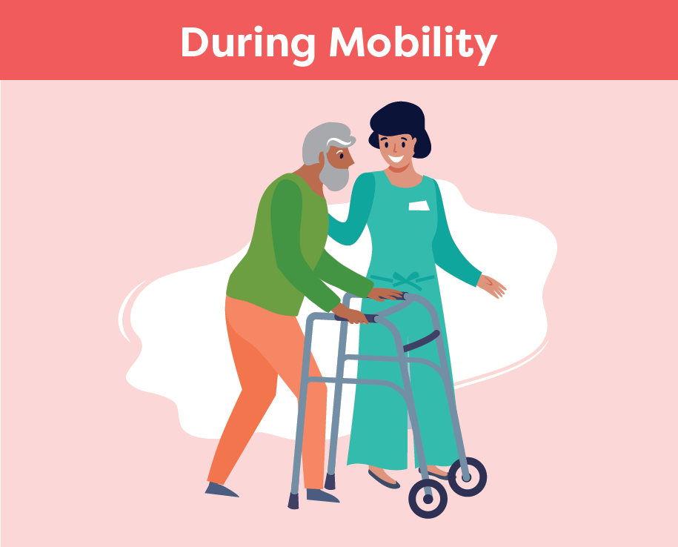
Mobility After Stroke
Smart Tips – Always follow the care plan!
Position yourself on the person’s affected side and as close as possible
Continue to communicate with the person
Offer verbal and visual cues for each step of the activity
Provide support at the shoulder blade, the hip, or waist
Never hold onto clothing or pull on the person’s affected arm
Notes:
Smart Tips- this section pertains what should happen during mobility
Position yourself on the person’s affected side and as close as possible (front/side). Be sure not to block the direction of movement or the person’s vision of the path of movement
Continue to communicate with the person. Offer verbal and visual cues for each step of the activity and allow time for them to understand and respond
Provide support at the shoulder blade, the hip, or waist to help guide the movement. Never hold onto clothing. Never pull on the person’s affected arm
See SMART TIPS for Stroke Care: Transfers after Stroke for additional details on transfers.

Slide 13
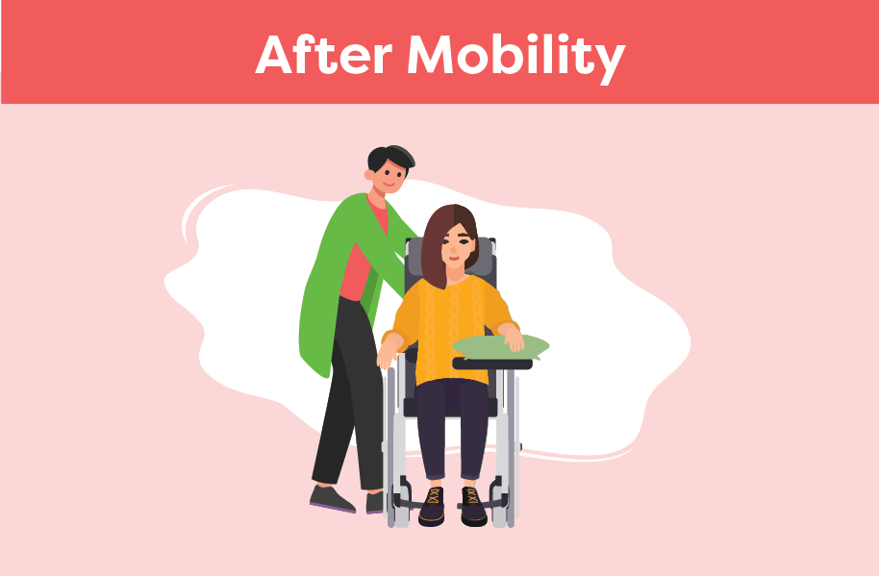
Mobility After Stroke
Before you leave, ensure that the person is well supported, safe and comfortable
Ensure that all necessary items are within reach
Check on the person and offer position changes frequently
Let the team know if there is a change in mobility status
Notes:
Smart Tips- this section pertains to things you should do after mobility
Before you leave, ensure that the person with stroke is well supported and is in a safe and comfortable position (See Smart Tips for Stroke Care- Positioning in a chair/ wheelchair after stroke)
Ensure that all necessary items (i.e. call bell) are within reach
Check-in on the person and offer position changes frequently
Let the team know if there is a change in their mobility status

Slide 14
Mobility After Stroke
Seek extra support
Occupational Therapists and Physiotherapists are skilled in mobility and transfers. It may be helpful to involve them in the person’s care
If communication is impacting mobility, consider consulting a Speech Language Pathologist
Smart Tips for Stroke Care (2023) was created by members of the Regional Stroke Networks of Ontario. This material may be shared without permission from the authors, without changes and with source credited.
Notes:
Seek extra support
Occupational Therapists and/or Physiotherapists are skilled in mobility and transfers. It may be helpful to involve these team members if you have questions
It may also be beneficial to speak to the speech language pathologist to determine communication strategies as these have significant implications for mobility (i.e. patient may need tools to communicate that they are in pain/uncomfortable during mobilization).

