Slide 1
TOPIC:
Behaviour
After Stroke

Slide 2
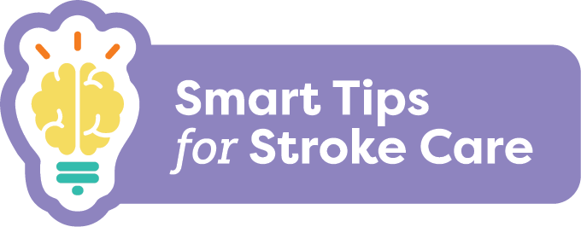
Behaviour After Stroke
After a stroke, people may experience changes in behaviour that can be the result of damage to the brain.
Some changes may include:
Quick shifts in emotions
Anger and aggression
Lack of interest/energy
Actions that are out of character for the person
Notes:
After a stroke, people may experience changes in behaviour that can be the result of damage to the brain.
Some changes may include:
quick shifts in emotions,
anger and aggression,
lack of interest/energy
actions that are out of character for the person.

Slide 3
Behaviour After Stroke
The impact of stroke on behaviour depends on:
where the stroke was in the brain
how long ago it happened
how severe the stroke was
how they behaved before the stroke
How the person is adapting to the effects of the stroke can affect behaviour as well.
Notes:
The impact of stroke on behaviour depends on:
where the stroke was in the brain
how long ago it happened
how severe the stroke was
how they behaved before the stroke
How the person is adapting to the effects of the stroke can affect behaviour as well.

Slide 4
Behaviour After Stroke
What you should know:
All behavior has meaning
Common triggers include:
Pain
Loneliness
Boredom
Frustration due to lack of independence
Frustration due to difficulty communicating
Notes:
All behavior has meaning.
Common triggers include:
Pain
Loneliness
boredom
lack of independence with activities such as toileting or dressing
Some behaviour changes can be related to frustration as a result of difficulty communicating

Slide 5
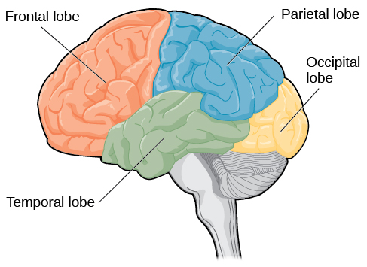
Behaviour After Stroke
What you should know:
Behaviour changes are commonly related to damage to the frontal lobe
Behaviour changes are not attention seeking, but are most likely due to the stroke, and may be the person’s way of expressing their needs
Notes:
Behaviour changes are commonly related to damage to the frontal lobe
Behaviour changes are not attention seeking, but are most likely due to the stroke and may be the person’s way of expressing their needs

Slide 6
Behaviour After Stroke
What you should know:
Changes may not be consistent
Stroke can have an impact on personality
Some people may have less control over their emotions
Laughing or crying at inappropriate times can occur
Behaviour changes can impact a person’s quality of life
Notes:
Changes may not be consistent. There may be good days, bad days and variations throughout the day
Stroke can have an impact on personality which can be hard on the person with stroke, their loved ones or other caregivers
Some people may have less control over their emotions and/or get upset over things that would not usually bother them
Laughing or crying at inappropriate times can occur; this is referred to as emotional lability
Behaviour changes can impact a person’s quality of life and can lead to negative outcomes such as social isolation and depression

Slide 7
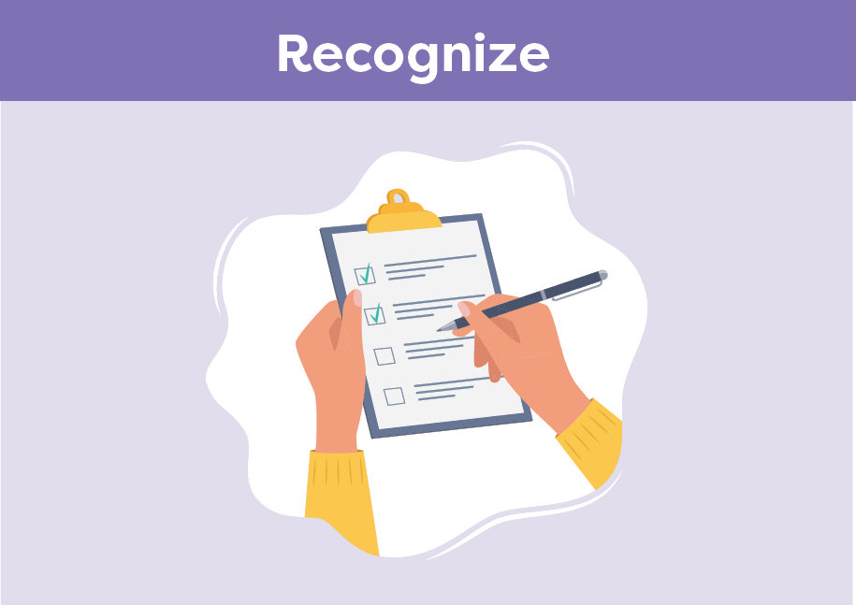
Behaviour After Stroke
Smart Tips:
Identify what triggers responsive behaviours and share information with the team
Be aware when someone is starting to feel anxious or frustrated and consider how you might respond
Notes:
Smart Tips “Always follow the care plan”. This section pertains to recognizing changing behaviour
Recognize
Identify what triggers responsive behaviours and share information with the team
Be aware when someone is starting to feel anxious or frustrated and consider how you might respond (e.g. removing the person from a loud environment)

Slide 8
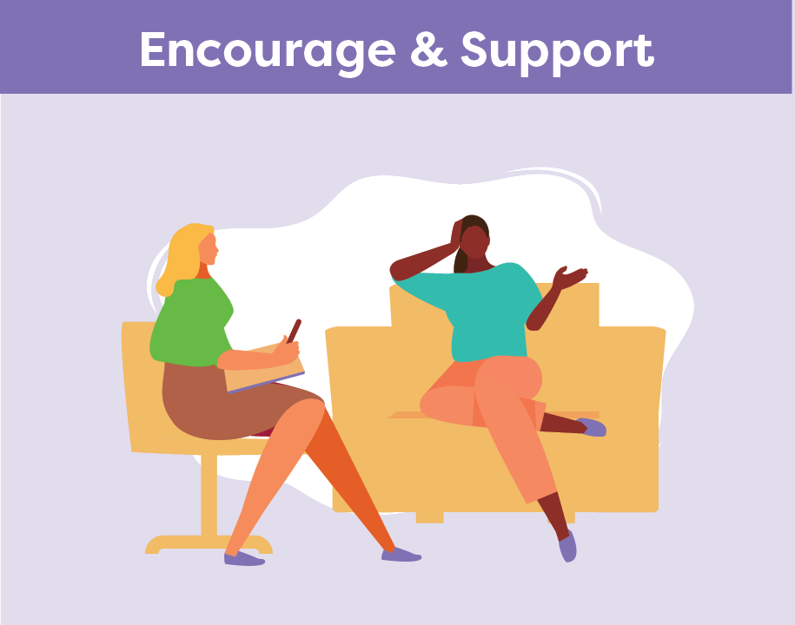
Behaviour After Stroke
Look for ways to promote independence
Offer to take a break
Explain what you are planning to do
Identify coping strategies
Encourage involvement in meaningful activities
Notes:
This section pertains to providing encouragement and support
Look for ways to promote independence
Offer to take a break to reduce frustration and try again later
Explain what you are planning to do and involve the person in their care
Identify coping strategies to support a person to manage their emotions
Encourage involvement in meaningful activities

Slide 9
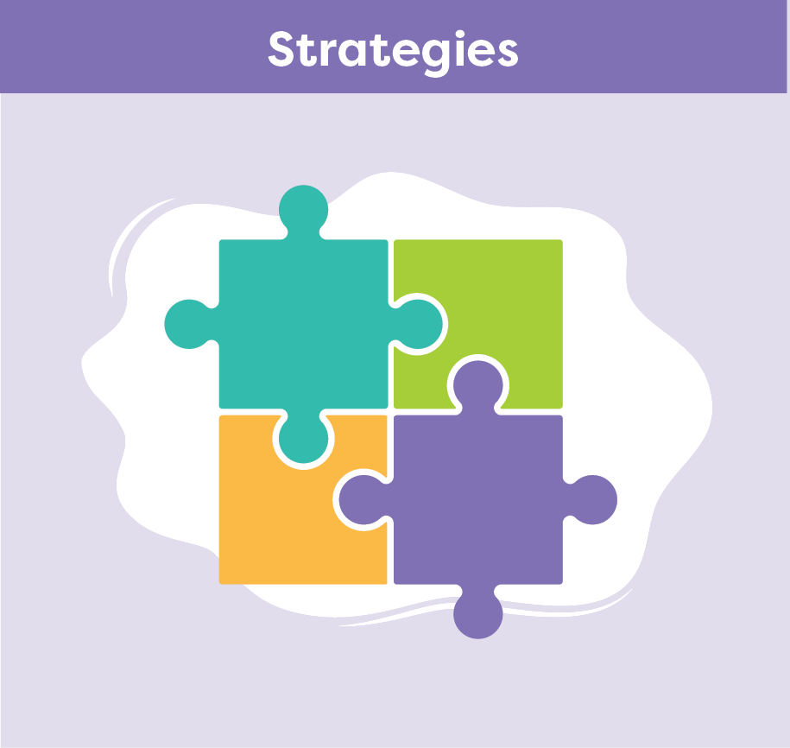
Behaviour After Stroke
Get to know the person and what they enjoy
Speak in a quiet, calm manner
Reinforce positive behaviour
Keep a consistent routine and respect preferences when possible
Offer reassurance that loss of emotional control is common after stroke
Use a problem solving approach to care
Share known triggers and effective coping strategies with the team
Notes:
This section pertains to strategies:
Get to know the person and what they enjoy
Speak in a quiet, calm manner and be patient
Reinforce positive behaviour and when appropriate, inform the person when their behaviour is inappropriate
Keep a consistent routine and respect preferences when possible
Reassure the family and the person with stroke that loss of emotional control is common after stroke
Use a problem solving approach to care- expect to try a number of strategies before you find one that works, and what works today may not work another time, keep trying!
Share known triggers as well as any effective coping strategies with the team

Slide 10
Behaviour After Stroke
Seek extra support
Family can help you learn more about the person you are caring for
Recreation Therapists are skilled in supporting persons with stroke to engage in meaningful activities
If you are struggling with behaviour challenges, connect with the team to involve other professionals or access additional supports
Smart Tips for Stroke Care (2023) was created by members of the Regional Stroke Networks of Ontario. This material may be shared without permission from the authors, without changes and with source credited.
Notes:
Knowing what the person enjoys can help with providing care. Family can help you learn more about the person you are caring for. Share this information with the team
Recreation Therapists are experts in supporting persons with stroke to engage in meaningful activities. It may be helpful to involve them in the persons care
If you are struggling with behaviour challenges, connect with the team about accessing supports in your area
Occupational therapists can help with cognitive or functional limitations that cause frustration
Speech Language Pathologists can help with communication support
Physiotherapists can help if there’s pain

