Slide 1
TOPIC:
Cognition
After Stroke

Slide 2
Cognition After Stroke
Cognition refers to how a person thinks and understands and can include:
Attention
Orientation
Memory
Insight
Impulse control
Cognitive changes can occur due to damage to the brain
As many as 2/3 of persons with stroke experience cognitive changes
Notes:
Cognition refers to how a person thinks and understands.
Cognition includes attention, orientation, memory, insight, impulse control, planning, problem-solving and decision-making.
Cognitive changes can occur due to damage to the brain after a stroke.
Mood, anxiety, fatigue, sleep, pain and medications are common factors that can also affect cognition after a stroke.
As many as two-thirds of persons with stroke experience cognitive changes.

Slide 3
Cognition After Stroke
What you should know:
Changes to cognition are less visible than physical changes
Cognitive changes can affect safety and quality of life.
People may:
have difficulty remembering recent or past event
be easily distracted and need more time to think things through
have difficulty recognizing their limitations and abilities
act quickly without thinking
Notes:
What you should know:
Changes to cognition are less visible than physical changes but can be just as or more significant
Individual impacts of cognitive changes vary from person to person
Cognitive changes can affect safety and quality of life. People with cognitive changes may:
have difficulty remembering recent or past event (e.g. not remembering to call for assistance before getting up)
not always be aware of who they are, where they are and/or the date and time
be easily distracted (e.g. wandering off topic or task in conversation or requiring repetition of instructions)
need more time to think things through and respond
have difficulty recognizing their limitations and abilities
act quickly without thinking (i.e. impulsive)
Have difficulty starting a task or getting stuck mid-task
Have difficulty being aware of how much time has gone by

Slide 4
Cognition After Stroke
Cognitive changes can cause distress, impact mood, lead to frustration and affect daily activities
Persons with cognitive changes function better with a structured routine that includes tasks that are meaningful to them
Notes:
What you should know continued…
The above changes can cause distress, impact mood, lead to frustration and affect daily activities
Persons with cognitive changes function better with a structured routine that includes tasks that are meaningful to them

Slide 5
Cognition After Stroke
Smart Tips:
Be patient
Speak slowly and clearly
Provide extra time
Make eye contact
Help the person establish a routine
Confirm that the person understands
Include the family in care
Notes:
Smart Tips – Always follow the care plan! This section pertains to how you can modify your approach
Be patient
Speak slowly and clearly. Use communication tools as needed. (See Smart Tips for Stroke Care – Communication After Stroke: Aphasia)
Provide extra time to allow the person to understand and respond
Make eye contact to help the person remain engaged in the task
Collaborate with the person to establish a consistent routine
Confirm that the person understands what you are asking of them
Include the family in care

Slide 6
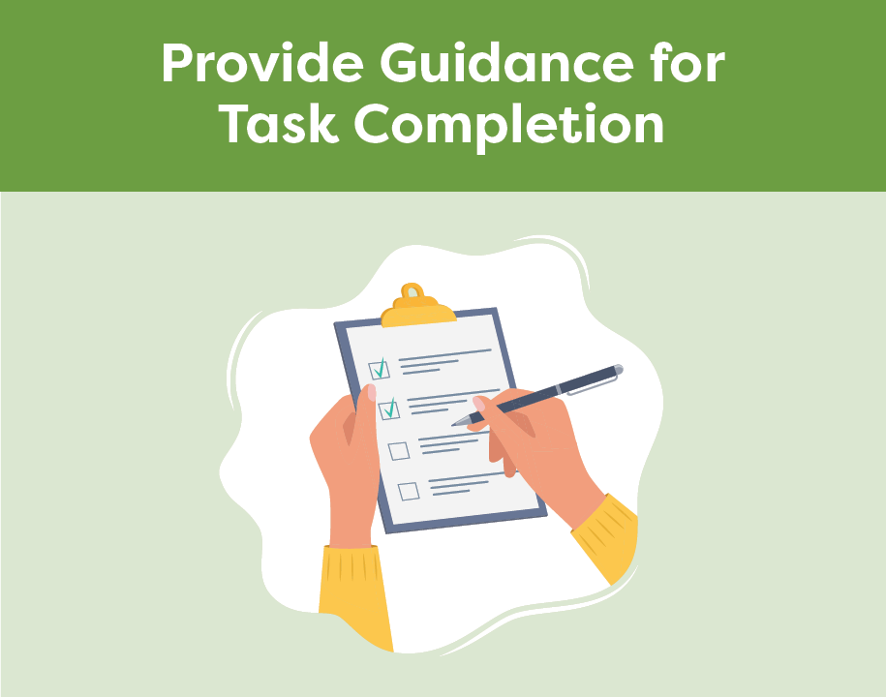
Cognition After Stroke
Give short and simple instructions
Help the person start the task
Focus on one activity at a time
Encourage the person to slow down
Repeat information and redirect
Notes:
This section pertains to providing guidance for task completion
Give short and simple instructions, one instruction at a time
Encourage or help the person to start the task
Break down the task into parts and focus on one activity at a time
Encourage the person to slow down
Repeat information and redirect as needed

Slide 7
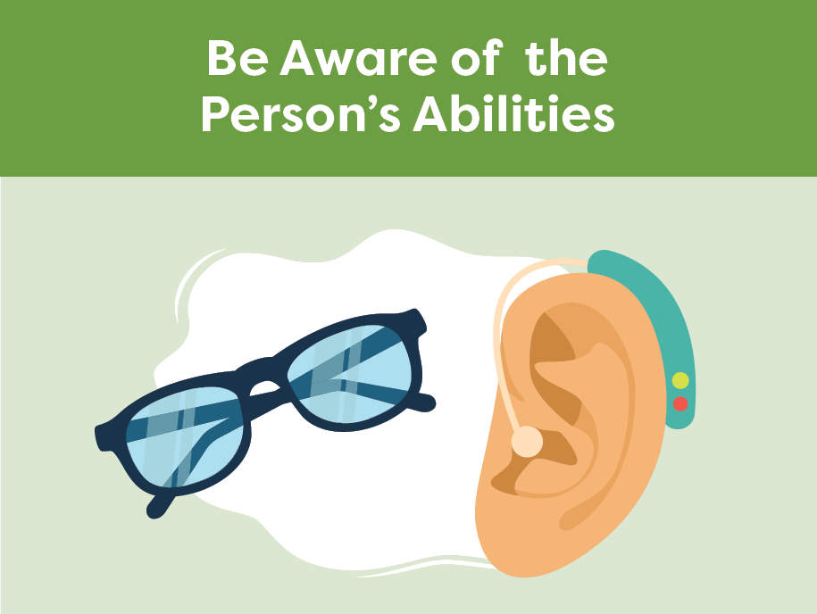
Cognition After Stroke
Get to know the person and their abilities
Gently remind the person of their current abilities and limitations
Make sure the person is ready to participate
Supervise as necessary
Notes:
This section pertains to being aware of the persons abilities
Get to know the person. Remember that they may not understand and appreciate their own abilities and limitations
Provide gentle reminders to the person of their current abilities since the stroke
Make sure the person is ready to participate (e.g. toileting completed, pain controlled, glasses and hearing aids in place)
Supervise as necessary

Slide 8
Cognition After Stroke
Minimize noise and distractions
Encourage the use of aids
Post reminders to promote safety
Help make the environment safe
Help personalize their room
Use labels/signs to help organize
Notes:
This section pertains to setting up the environment for success
Minimize noise and distractions (e.g. TV and radio)
Encourage the use of aids (e.g. calendars, journal, white board, daily plan)
Post reminders to promote safety (e.g. call for help, use your walker)
Help make the environment as safe as possible (e.g. call bell in place, mobility device nearby)
Help personalize their room (e.g. photos, familiar items)
Use labels and signs to help organize and locate items (e.g. picture of socks on drawer)

Slide 9
Cognition After Stroke
Seek extra support
Cognition should be monitored to understand the person’s abilities and develop a personalized care plan
If you notice a sudden change in cognition, report it to your team immediately
Occupational Therapists are skilled in cognition
Smart Tips for Stroke Care (2023) was created by members of the Regional Stroke Networks of Ontario. This material may be shared without permission from the authors, without changes and with source credited.
Notes:
Cognition should be monitored after stroke to understand the person’s abilities and develop a personalized care plan. You are the eyes and ears for the team
If you notice a sudden change in cognition, report it to your team immediately
Occupational Therapists have expertise in cognition. It may be helpful to involve them in the person’s care

