Slide 1
TOPIC:
Fatigue After Stroke

Slide 2
Fatigue After Stroke
Fatigue is a feeling of tiredness or lack of energy
One of the most common effects of stroke
Signs are not always obvious
Has a significant impact on everyday life
Notes:
Fatigue is a feeling of tiredness or lack of energy and is one of the most common effects of stroke.
The signs of fatigue are not always obvious but it can have a significant impact on the person’s ability to function day to day and participate in activities.

Slide 3
Fatigue After Stroke
What you should know:
Fatigue after stroke:
Can affect up to half of persons with stroke
Often starts in the first few weeks; can happen at any point
Is different from typical tiredness
Does not always improve with rest
May affect a person’s quality of life and relationships
Can be mistaken for depression
Notes:
Fatigue after stroke:
Can affect up to half of persons with stroke but is manageable when using a team approach
Often starts in the first few weeks after a stroke but can happen at any point
Is different from the typical tiredness that everyone feels from time to time. After a stroke, even tasks like moving, thinking, talking – can take more effort than it did before
Is not necessarily related to activity, does not always improve with rest and the person may constantly feel exhausted
May affect a person’s quality of life and relationships, as family and friends may not understand how genuinely exhausted the person is
Can be mistaken for depression. However, it is important to know that fatigue and depression are different, and each problem needs to be recognized and managed separately

Slide 4
Fatigue After Stroke
Intensity of fatigue does not seem to be related to type or severity of stroke
Factors that can impact fatigue:
Noisy or busy environments
Complex activities such as social events, bingo, etc.
Poor sleep or breathing problems while asleep (e.g. sleep apnea)
Poor nutrition
Pain
Some medications
Other medical conditions (e.g. thyroid problems)
Notes:
The intensity of fatigue does not seem to be related to the type or severity of the stroke. A person with a very mild stroke can experience fatigue
Other factors can have an impact on fatigue after stroke. These include:
Noisy or busy environments
Complex activities such as social events, bingo, etc.
Poor sleep or breathing problems while asleep (e.g. sleep apnea)
Poor nutrition
Pain
Some medications
Other medical conditions (e.g. thyroid problems)

Slide 5
Fatigue After Stroke
Smart Tips:
Encourage communication about level of fatigue
Encourage any participation, even if only partially or for a short time
Notes:
Smart Tips – Always follow the care plan! This section pertains to encouragement & support.
Encourage good communication by asking the person about their level of fatigue before, during and after an activity
Encourage participation in activities the person enjoys, even if only partially or for a short time

Slide 6
Fatigue After Stroke
Adequate sleep
Nutrition
Exercise
Notes:
This section pertains to Promoting Healthy Habits.
Adequate sleep (keep a regular sleep schedule)
Nutrition (e.g. eat a healthy diet, drink enough water and avoid alcohol)
Exercise (even small amounts can help improve fatigue over time)

Slide 7
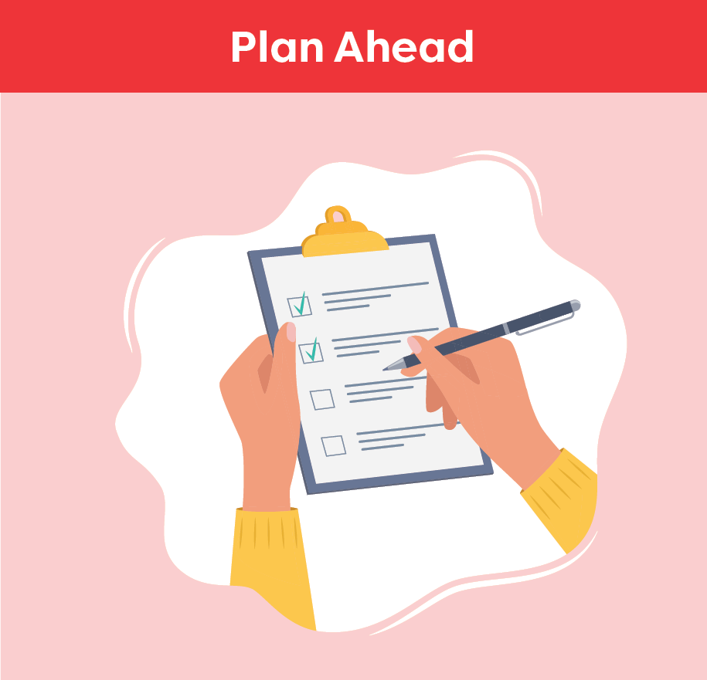
Fatigue After Stroke
Complete important activities first
Do tasks in a way that uses less energy
Organize the environment
Plan activities for when the person will have the most energy
Balance periods of activity and rest
Plan extra time
Notes:
This section pertains to planning ahead.
Have the person identify which activities are the most important to them, and plan to complete those activities first
Help the person to do tasks in a way that uses less energy, such as sitting when possible
Organize the environment to make tasks easier, such as having the necessary items close by
Plan activities for when the person will have the most energy. Balance periods of activity with periods of rest. Plan extra time to accomplish a task

Slide 8
Fatigue After Stroke
Do not push the person to do too much if they are having a ‘better day’
Everyone’s level of fatigue will be different
Fatigue can be unpredictable
Notes:
This pertains to planning ahead.
Do not push the person to do too much if they are having a ‘better day’. This may leave them exhausted for the next day or two
Recognize that everyone’s level of fatigue will be different and that fatigue can be unpredictable

Slide 9
Fatigue After Stroke
Highlight their successes in using strategies to manage their fatigue
Focus on what they can do
Notes:
This pertains to celebrating success.
Observe the person’s progress over time and highlight the success they have had in using strategies to manage their fatigue
Remind them of what they can do instead of focusing on what they cannot do

Slide 10
Fatigue After Stroke
Seek extra support
Occupational Therapists and Physiotherapists can help with strategies
Tell the team if you notice a change
Seek medical advice for any conditions that may be contributing to fatigue
Smart Tips for Stroke Care (2023) was created by members of the Regional Stroke Networks of Ontario. This material may be shared without permission from the authors, without changes and with source credited.
Notes:
Occupational Therapists and Physiotherapists can help with strategies to manage fatigue. It may be helpful to involve them in a person’s care
Tell the team if you notice a change in a person’s fatigue level and seek medical advice for any conditions that may be contributing to fatigue

