Slide 1
TOPIC:
Depression After Stroke

Slide 2
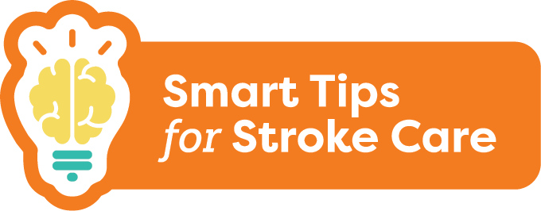
Depression After Stroke
1 in 3 people will experience depression after stroke
Is a mood disorder that can occur following an injury to the brain
Can affect how an individual thinks, feels or behaves
Does not go away on its own and requires treatment
Notes:
1 in 3 people who have had a stroke will experience depression
Depression is a mood disorder that can occur following an injury to the brain
Depression can affect how an individual thinks, feels or behaves and it can influence daily life functioning
It is normal to feel sad after a stroke, but this feeling typically goes away in time. Depression does not go away on its own and requires treatment.

Slide 3
Depression After Stroke
What you should know:
Early recognition is key!
Risk is greatest in the first 3-6 months
Signs of depression can be mistaken for the effects of stroke or aging
Signs of depression can also be overlooked or missed when a person has difficulty speaking or thinking
Depression is treatable with medications and/or counselling
Can affect a person’s quality of life and ability to enjoy activities
Risk of depression increases at times of change
Notes:
The risk of depression is greatest in the first 3-6 months after a stroke, but a person can develop depression years later
Signs of depression can be mistaken for the effects of stroke or aging
Signs of depression can also be overlooked or missed when a person has difficulty speaking or thinking
Early recognition is key. Depression is treatable. The most common treatments for depression are medications and counselling. The person may need to try several medications before finding one that works best. Medications may take several weeks to work before you notice a change (e.g 6-8 weeks).
If not treated, depression can affect a person’s ability to enjoy activities, participate in their own care and interact with family and friends. Depression can impact quality of life
Risk of depression increases at times of change, so a person should be monitored when moving into a new setting such as a long-term care home

Slide 4
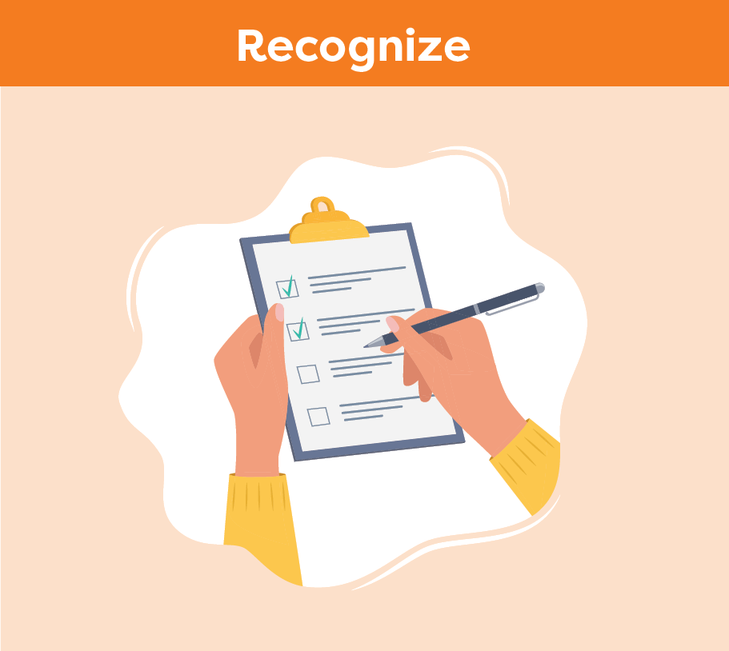
Depression After Stroke
Smart Tips:
Look for Signs of Depression:
Feeling hopeless, helpless or worthless
Feeling sad, anxious, irritable or angry
Loss of interest and withdrawal
Appetite, weight and sleep pattern changes
Headaches, chronic pain, digestive problems
Notes:
Smart Tips – Always follow the care plan! This section pertains to recognizing the signs of depression
Look for Signs of Depression:
Feeling hopeless, helpless or worthless
Feeling sad, anxious, irritable or angry
Loss of interest and withdrawal
Appetite, weight and sleep pattern changes
Headaches, chronic pain, digestive problems
Other considerations include negativity, feeling gloomy and dark, feeling of living in a fog, slow movements.

Slide 5
Depression After Stroke
Look for Signs of Depression:
Fatigue/lack of energy
Memory, concentration problems, confusion and slow thoughts
Difficulty making decisions
Thoughts of death, dying or suicide
Notes:
Smart Tips – Always follow the care plan!
Look for Signs of Depression:
Fatigue/lack of energy
Memory, concentration problems, confusion and slow thoughts
Difficulty making decisions
Thoughts of death, dying or suicide
Other considerations include negativity, feeling gloomy and dark, feeling of living in a fog, slow movements.

Slide 6
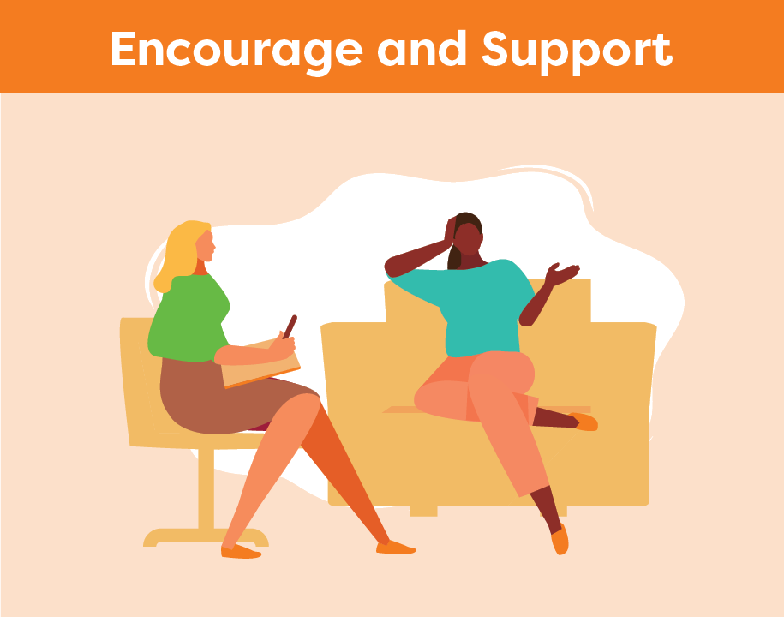
Depression After Stroke
Consistent routine
Help the person plan and structure
Encourage participation in activities of interest
Encourage the person to share their feelings
Listen actively and offer support
Always be hopeful
Notes:
This section pertains to encouragement and support
Add structure to the day by keeping a consistent routine
Help the person plan and structure their day. If necessary, break larger tasks into smaller ones.
Encourage the person to participate in activities they enjoy. Promote self-care.
Find activities that can make the person feel better, such as exercise, social activities, listening to music, or reading
Encourage the person to share their feelings
Listen actively and offer support. Don’t be judgmental.
Always be hopeful when working with a person with depression

Slide 7
Depression After Stroke
Educate the person and their family about depression
Remind them that depression is a medical illness
Learn how to communicate with people who have aphasia
Notes:
This section pertains to education about depression
Educate the person and their family about depression and the impact that stroke can have on mood. Remind them that depression is a medical illness.
Learn how to communicate with people who have aphasia
See Smart Tips for Stroke Care - Communication After Stroke: Aphasia

Slide 8
Depression After Stroke
Seek extra support
Look for signs and symptoms of depression and report any differences in mood to your team
Refer to a health care provider with the ability to assess and treat depression
Get help immediately if a person is talking about death, dying or suicide
Smart Tips for Stroke Care (2023) was created by members of the Regional Stroke Networks of Ontario. This material may be shared without permission from the authors, without changes and with source credited.
Notes:
Look for signs and symptoms of depression and report any differences in mood to your team
All people showing signs and symptoms of depression should be referred to a health care provider with the ability to assess and treat depression. Some examples of health care providers that can help include the social worker, physician and nurse practitioner.
Ensure that you get help immediately if a person is talking about death, dying or suicide

