Slide 1
TOPIC:
Communication After Stroke: Aphasia

Slide 2
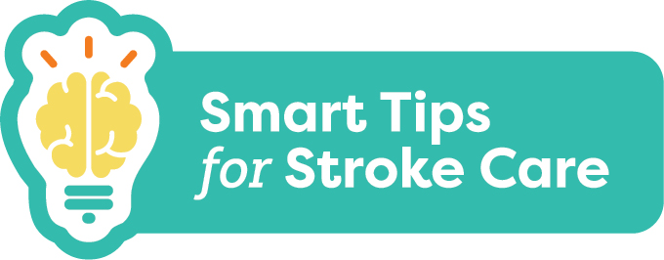
Communication
After Stroke: Aphasia
Communication problems are common after a stroke
Aphasia is a common communication impairment and can affect a person’s ability to:
speak
read
write
understand what others say
Notes:
Communication problems are common after a stroke. Aphasia is a common communication impairment. It can affect a person’s ability to speak, read, write, and understand what others say.

Slide 3
Communication
After Stroke: Aphasia
What you should know:
1 in 3 people with stroke will have aphasia
Aphasia impacts a person’s ability to use language
Aphasia does NOT impact intelligence
Communicating with someone with aphasia can take time and effort
Aphasia can lead to frustration, social isolation and depression
Better communication can improve care and quality of life
Notes:
1 in 3 people who have had a stroke will have aphasia
Aphasia impacts a person’s ability to use language. It does NOT impact their intelligence. They may know more than they can say
Communicating with someone with aphasia can take time and effort for both you and the person with aphasia. It gets easier with practice
Aphasia can lead to frustration, social isolation and depression
Better communication can improve care and quality of life for the person with aphasia

Slide 4
Communication
After Stroke: Aphasia
A person may have one or both of the following types of aphasia:
Receptive Aphasia - trouble taking messages IN; difficulty understanding what is heard or read
Expressive Aphasia - trouble getting messages OUT; difficulty speaking or writing
Notes:
A person may have one or both of the following types of aphasia:
Receptive Aphasia - trouble taking messages IN; difficulty understanding what is heard or read
Expressive Aphasia - trouble getting messages OUT; difficulty speaking or writing

Slide 5
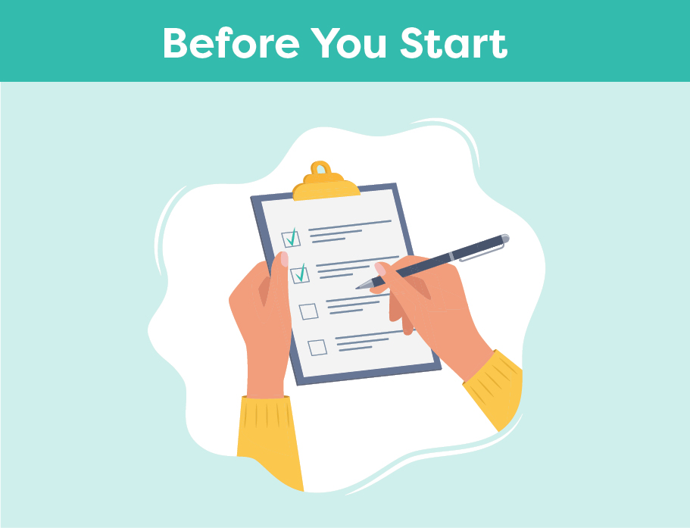
Communication
After Stroke: Aphasia
Smart Tips:
Ensure adequate lighting
Reduce noise and distractions
Ensure hearing aids, glasses and/or dentures are in use
Position yourself face to face at eye level
Plan for extra time and be patient
Notes:
Smart Tips – Always follow the care plan! This section pertains to actions to take before you start
Ensure adequate lighting
Reduce noise and distractions
Ensure the person’s hearing aids and glasses and/or dentures are in place if needed
Position yourself face to face and at eye level with the person
Plan extra time for your interaction and be patient

Slide 6
Communication
After Stroke: Aphasia
Make sure the topic of conversation is very clear
Speak in short simple sentences
Ask YES/NO questions
Offer choice
Notes:
Smart Tips – Always follow the care plan! This section pertains to how to keep it simple
Make sure you both know the topic and be very clear when the topic changes
Speak in short simple sentences
Ask YES/NO questions
Offer choice: “Do you want A or B, or neither?”

Slide 7
Communication
After Stroke: Aphasia
Speak slowly and clearly
Use a normal tone and volume
Acknowledge competence “I know you know”
Include the person with aphasia in conversations
Avoid interrupting
Notes:
Smart Tips – Always follow the care plan! This section pertains to being respectful when communicating
Speak slowly and clearly in a normal tone and volume
Acknowledge competence “I know you know”
Include the person with aphasia in conversations - do not speak for them
Avoid interrupting, allow them time to finish their sentence

Slide 8
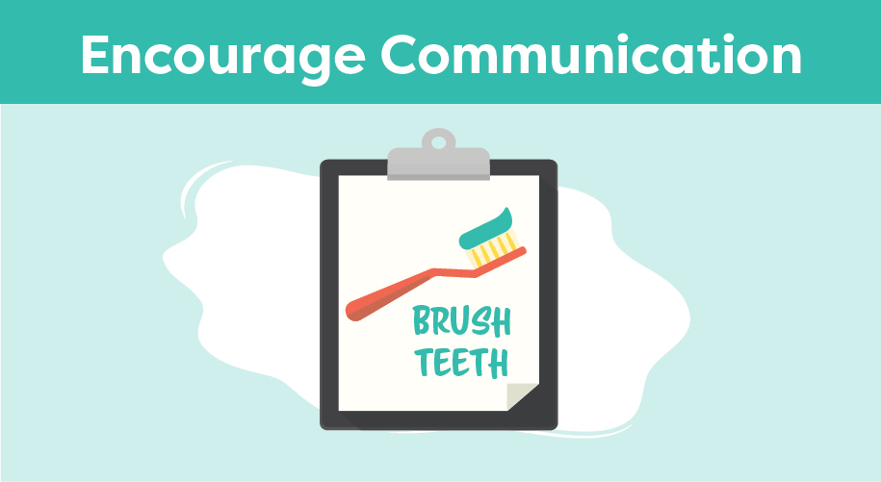
Communication
After Stroke: Aphasia
Use gestures
Write down key words
Have them point to words or pictures
Notes:
Smart Tips – Always follow the care plan. This section pertains to encouraging communication
Use gestures
Write down key words during your interaction
Have them point to words or pictures; use a communication board

Slide 9
Communication
After Stroke: Aphasia
Repeat what you think the person said
Pay attention to body language and facial expressions
Acknowledge frustration
Offer to try again later
Notes:
Smart Tips – Always follow the care plan! This section pertains to confirming the message
Repeat what you think the person said to verify what you understood
Pay attention to body language and facial expressions
Acknowledge frustration, it’s okay to admit that you don’t understand
Offer to try again later

Slide 10
Communication
After Stroke: Aphasia
Seek extra support
Speech Language Pathologists are skilled in communication
For more information about Aphasia, please visit the Aphasia Institute https://www.aphasia.ca/
Smart Tips for Stroke Care (2023) was created by members of the Regional Stroke Networks of Ontario. This material may be shared without permission from the authors, without changes and with source credited.
Notes:
Speech Language Pathologists are the experts in communication. It may be helpful to involve them in the person’s care
For more information about Aphasia, please visit the Aphasia Institute https://www.aphasia.ca/

