Slide 1
TOPIC:
Eating and Swallowing After Stroke

Slide 2
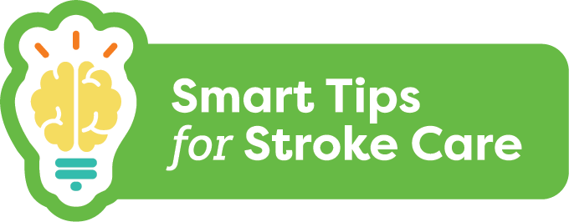
Eating and Swallowing
After Stroke
Dysphagia:
Means trouble swallowing
Results from damage to the brain
May require changes to food textures and liquids for safety
Notes:
Dysphagia means trouble swallowing and can result from damage to the brain such as a stroke.
When a person has dysphagia, they may need changes to their food textures and liquids to ensure that they can safely eat and drink.

Slide 3
Eating and Swallowing
After Stroke
What you should know:
Up to 65% of people will have dysphagia
Pneumonia can occur when food or liquids “go down the wrong way”
Oral care should be done before and after meals and at bedtime
Poor intake can lead to weight loss and dehydration
Social isolation can occur for many people living with dysphagia
Notes:
Up to 65% of people will have dysphagia following a stroke
Pneumonia can occur when food or liquids “go down the wrong way” (known as aspiration pneumonia)
Oral care before and after meals and at bedtime can help reduce risk of aspiration pneumonia
Fear of choking and/or a change in food texture or thickened fluids can result in poor intake. This can lead to weight loss and dehydration
Social isolation can occur for many people living with dysphagia. It is important to include them in social activities and be sure they can join with safe food and beverage options

Slide 4
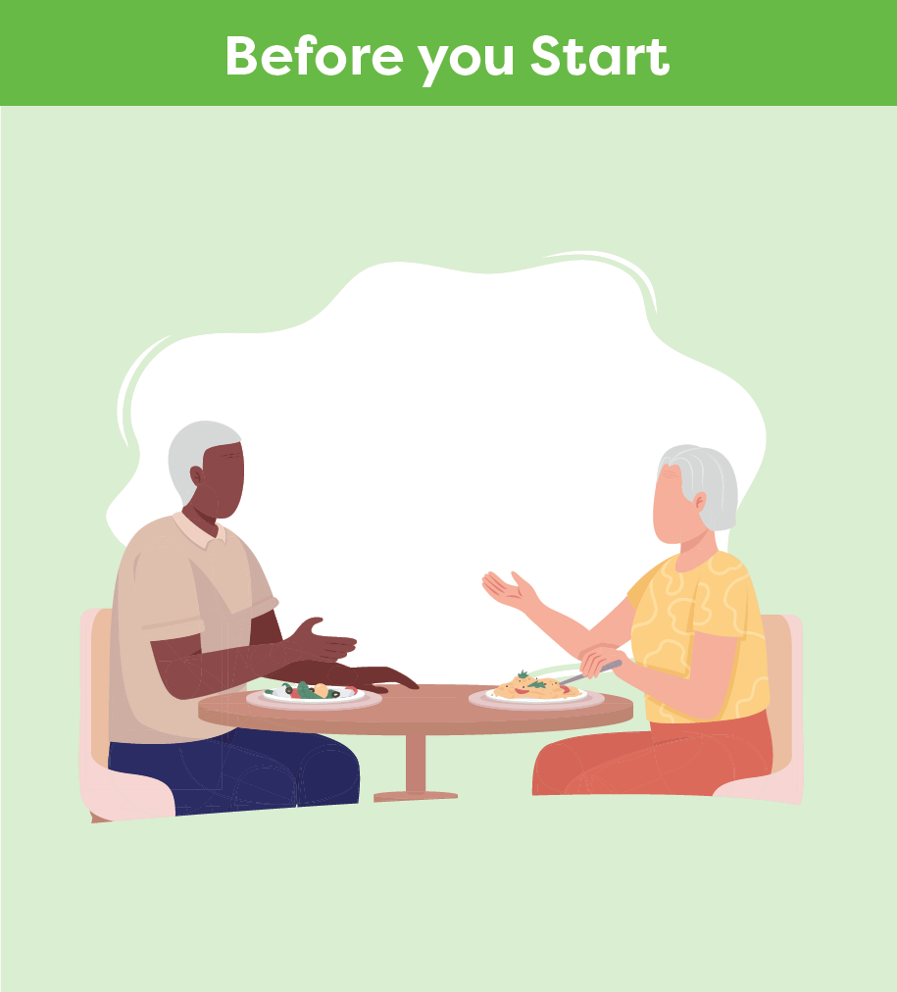
Eating and Swallowing
After Stroke
Smart Tips:
Perform hand hygiene
Ensure the person is alert
Use assistive devices as needed
Ensure dentures are in place and fit well
Notes:
Smart Tips – Always follow the care plan! This section pertains to steps you should take before you start helping a person with stroke eat
Perform hand hygiene
Ensure the person is alert
Follow the suggestions by therapy staff for use of assistive devices as needed (controlled sip cups, built-up utensil handles, plate guard, anti-slip mat, etc.)
Ensure dentures are in place and fit well

Slide 5
Eating and Swallowing
After Stroke
Place yourself face to face and at eye level or sit on the person’s unaffected side
Check that the person is upright for the meal
Ask for help if you are not sure a food is right for the person
Notes:
Smart Tips – Always follow the care plan! This section pertains to steps you should take before you start helping a person with stroke eat
Place yourself face to face and at eye level with the person. If unable to do so, sit on the person’s unaffected side
Check that the person is upright for the meal (unless otherwise noted in the care plan)
Ask for help if you are not sure a food is right for the person. Check the care plan for safe options (e.g. popsicles, ice cream and/or milkshakes may not be okay for everyone)

Slide 6
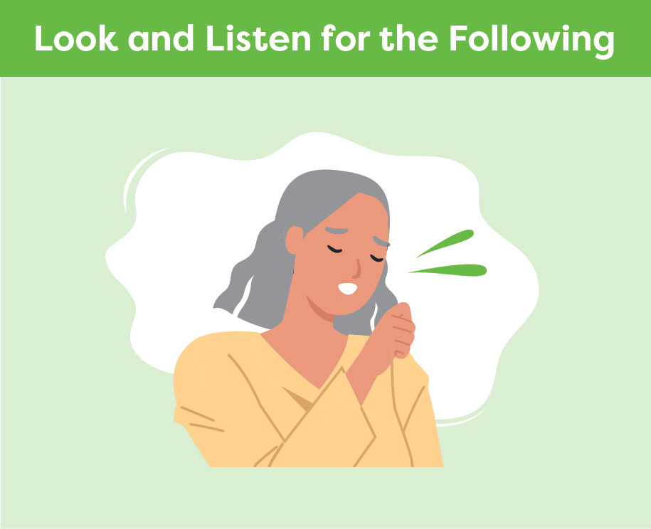
Eating and Swallowing
After Stroke
Watch for signs of trouble swallowing:
Pocketing of food or pills
Taking a long time to eat
Drooling or spitting out food
Shortness of breath after meals
A wet or gurgly voice
Throat-clearing
Coughing or choking
Person reporting issues
Notes:
Smart Tips – Always follow the care plan! This section pertains to things you should look or listen for while a person is eating
Pocketing of food or pills in the mouth or cheeks and under tongue
Taking a long time to eat
Drooling or spitting out food
Shortness of breath after meals
A wet or gurgly voice
Throat-clearing
Coughing or choking
The person reporting that something is sticking in their throat, their throat feels tight or they describe signs of heartburn

Slide 7
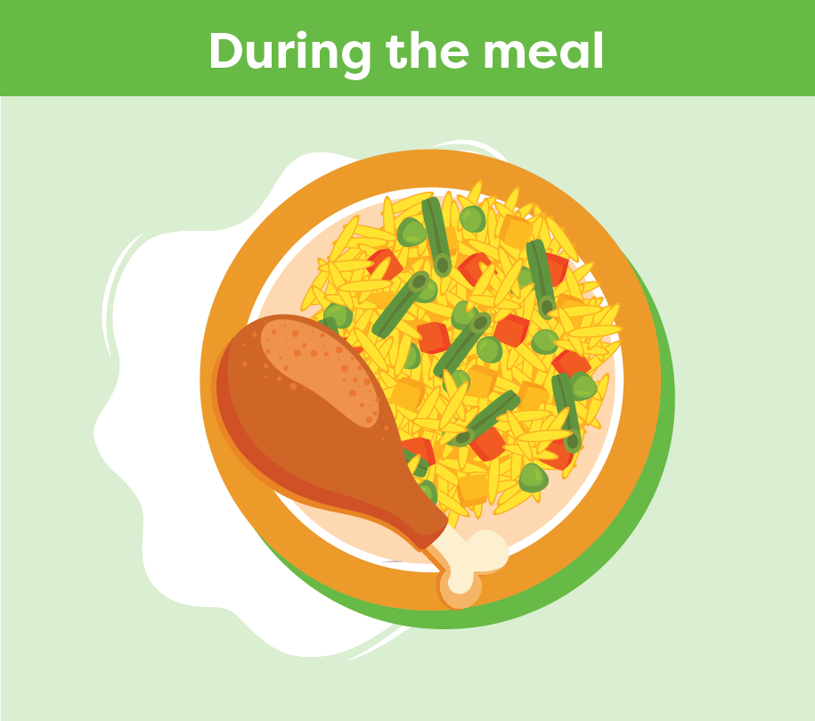
Eating and Swallowing
After Stroke
Be patient and avoid rushing
Avoid talking when the person is eating
Decrease distractions
Eat slowly
Encourage to feed themself when able
Confirm the mouth is clear
Let the person know what food they are being offered
Be positive!
Notes:
Smart Tips – Always follow the care plan! This section pertains to ways you can support a person during the meal
Be patient and avoid rushing the meal
Avoid talking when the person is eating
Decrease distractions
Support the person to eat slowly and feed themself when able
Confirm the mouth is clear before offering more food and again after the meal
Food can look different when the texture has changed. Be sure to let the person know what they are being offered
Be positive! This can have a big impact on how much the person will eat and their pleasure of mealtime

Slide 8
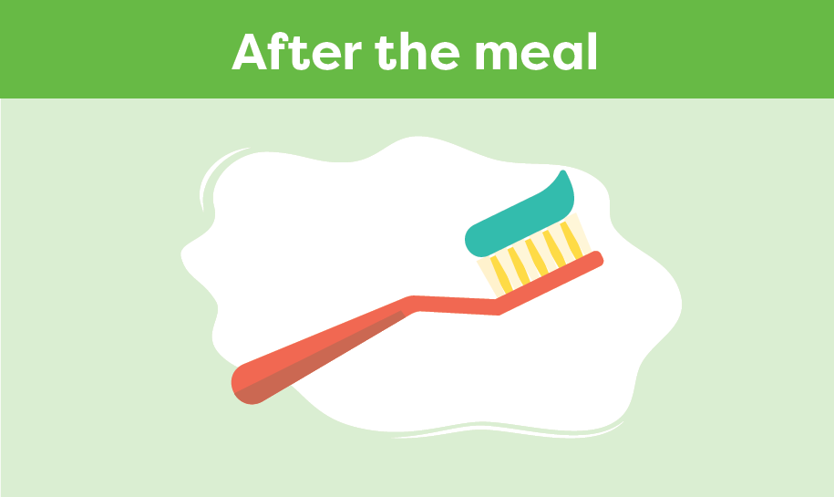
Eating and Swallowing
After Stroke
Keep upright for 30 minutes after eating
Check for pocketing of food
Encourage good oral care
Use a soft toothbrush
Notes:
Smart Tips – Always follow the care plan! This section pertains to things that you should do after a person eats.
Keep the person seated upright for 30 minutes after eating
Check for pocketing of food
Encourage good oral care. Provide help when needed with brushing teeth/dentures before and after meals
Use a soft toothbrush and avoid relying on oral swabs when assisting with oral care

Slide 9
Eating and Swallowing
After Stroke
Seek extra support
Swallowing can change over time. If you see any changes, report this to the team immediately
Registered Dietitians and Speech Language Pathologists are skilled in eating and swallowing
Smart Tips for Stroke Care (2023) was created by members of the Regional Stroke Networks of Ontario. This material may be shared without permission from the authors, without changes and with source credited.
Notes:
Careful monitoring is vital because swallowing can change over time and affect a person’s ability to eat and drink safely. If you see any changes in a person’s eating or swallowing, report this to the team immediately
Registered Dietitians and Speech Language Pathologists are skilled in eating and swallowing. It may be helpful to involve them in the person’s care

