Slide 1
TOPIC:
Bowel and Bladder Function After Stroke

Slide 2
Bowel and Bladder
After Stroke
Bowel and bladder incontinence are common after stroke
Can be a result of damage to the part of the brain that controls bowel and bladder function
Many factors (e.g. mobility) can increase bowel and bladder issues
People with bowel and bladder issues may:
require frequent trips to the bathroom
not make it to the bathroom in time
have issues with urinary tract infections
Notes:
Bowel and bladder incontinence (loss of control or poor control) are common after a stroke
Incontinence can be a result of damage to the part of the brain that controls bowel and bladder function
Many factors, such as a person’s ability to move, think and communicate, can increase bowel and bladder issues. As well, things such as equipment, room layout, medication and co-morbidities can also add to the issue
People with bowel and bladder issues may require frequent trips to the bathroom, may not make it to the bathroom in time and/or have issues with urinary tract infections

Slide 3
Bowel and Bladder
After Stroke
What you should know:
> 45% of persons with stroke in LTC experience incontinence
Bowel incontinence is less common than bladder incontinence
Women have higher rates of incontinence after stroke than men
Incontinence after stroke is associated with poor outcomes
Incontinence can lead to:
skin breakdown
infections
pain
falls
dehydration
Notes:
More than 45% of persons with stroke living in LTC experience bladder or bowel incontinence
Bowel incontinence is less common than bladder incontinence
Women have higher rates of incontinence after stroke than men
Incontinence after stroke is associated with poor outcomes including slower recovery, prolonged hospitalization, and low quality of life
Issues that can result from incontinence include skin breakdown, skin and bladder infections, dehydration, pain and falls

Slide 4
Bowel and Bladder
After Stroke
What you should know:
Incontinence may lead to isolation and issues with depression
Reducing incontinence can improve quality of life and self-esteem
Increased awareness of incontinence can help to reduce stigma
Notes:
Persons with stroke who have incontinence may also isolate more and have issues with depression
Reducing occurrences of incontinence can greatly improve quality of life and self-esteem
Increased awareness and knowledge of bowel and bladder incontinence among health care providers can help to reduce stigma and encourage individuals faced with these conditions to seek help

Slide 5
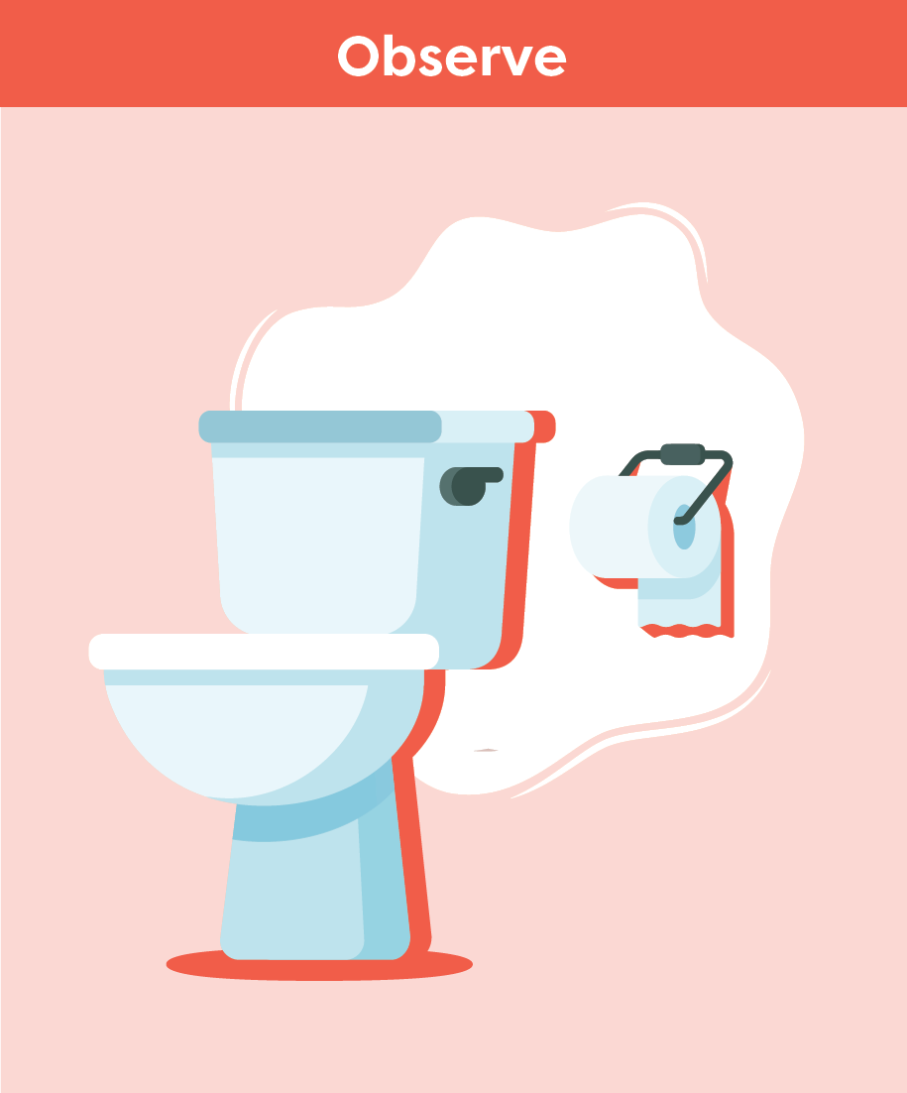
Bowel and Bladder
After Stroke
Smart Tips:
Assess factors that impact incontinence
Get to know the person and how they indicate their need to go to the bathroom
For language/communication barriers, use pointing/gestures or pictures
Monitor bowel and bladder patterns, diet and fluid intake
Notes:
Smart Tips – Always follow the care plan! This section pertains to observation.
Assess factors that could impact incontinence such as room layout, and/or visual, mobility and thinking deficits
Get to know the person with stroke and how they indicate their need to go to the bathroom. Can they ask? Do they need assistance? Are they agitated, restless or roaming? This could be a sign they need to use the bathroom
If language or communication is a barrier, encourage the person or provider/family to use pointing/gestures or pictures to indicate needs
Monitor bowel and bladder patterns, diet and fluid intake. For example, is the person refusing fluids because of fear of being incontinent

Slide 6
Bowel and Bladder
After Stroke
Recognize signs of incontinence, such as:
frequent urination
soiled/wet clothes or linens
strong odour
urine/feces on bathroom floors
toilet paper as padding inside the underwear
increased usage of incontinence products
Notes:
Smart Tips – Always follow the care plan! This section pertains to observation
Recognize signs of incontinence, such as frequent urination, soiled/wet clothes or linens, strong odour, urine/feces on bathroom floors, toilet paper as padding inside the underwear and/or increased usage of incontinence products

Slide 7
Bowel and Bladder
After Stroke
Closely watch for signs of urinary tract infection:
strong odour
minimal urine output
increased urgency
discomfort when urinating
blood in urine
lower abdominal/back pain/pressure
increased confusion/agitation
increased fatigue
fever
Notes:
Smart Tips – Always follow the care plan! This section pertains to observation.
Closely watch for possible signs of urinary tract infection, including strong odour, minimal urine output, increased urgency, discomfort when urinating, blood in urine, lower abdominal/back pain/pressure, increased confusion/agitation, increased fatigue and fever

Slide 8
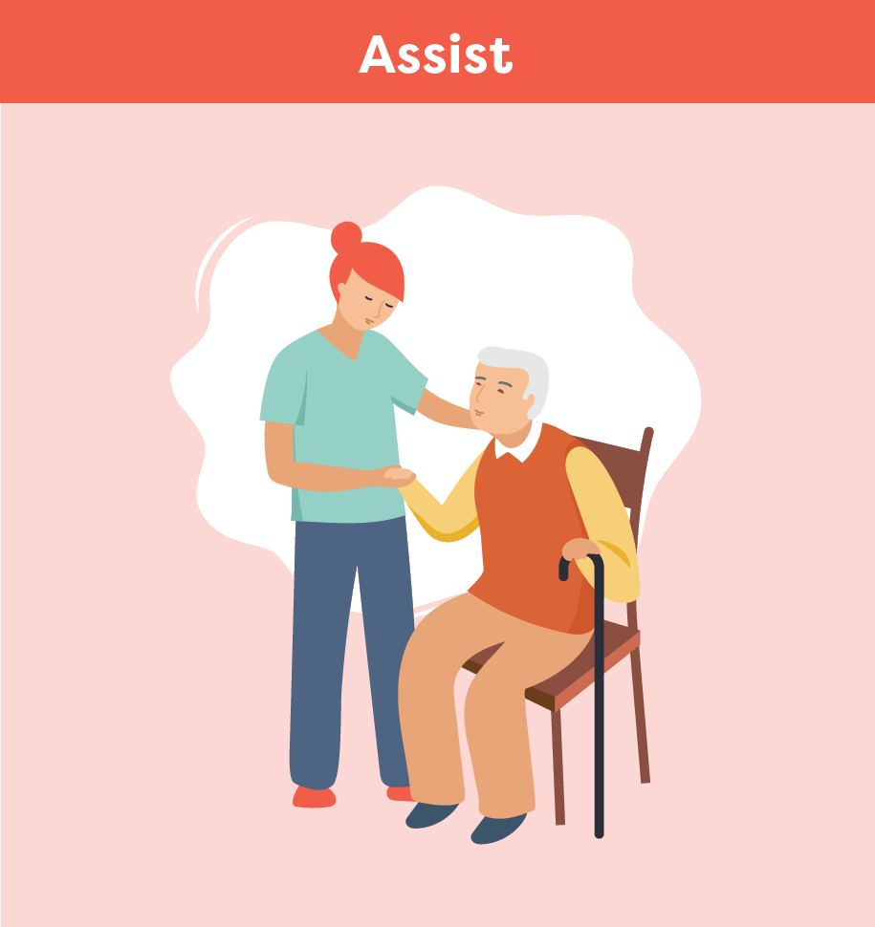
Bowel and Bladder
After Stroke
Set up the room for easy and safe access to the bathroom
Apply strategies from the care plan:
Encourage use of commode/urinal
Toileting 30 minutes after a meal
Regular toileting throughout day
Limit caffeine intake
Offering decaf coffee or herbal teas
Notes:
Smart Tips – Always follow the care plan! This section pertains to how you might assist the person:
Set up the room for easy and safe access to the bathroom
Always follow the care plan. For example, encourage use of a commode or urinal, toileting for a bowel movement 30 minutes after a meal, regular toileting throughout the day, limiting caffeine intake to 1-2 cups earlier in the day, offering decaf coffee or herbal teas

Slide 9
Bowel and Bladder
After Stroke
Encourage water intake, especially morning and early afternoon
Educate the person and their family
Provide emotional support and reassurance
Notes:
Smart Tips – Always follow the care plan! This section pertains to how you might assist the person:
Encourage water intake to meet daily fluid goals. Fluids can also be added to the diet through soups, yogurt, jello, ice cream, popsicles, watery fruit such as watermelon or grapes. If possible, arrange to have most fluid intake in the morning and early afternoon, less in the evening and prior to bedtime
Educate the person with stroke and their family on incontinence after stroke and encourage them to use the strategies put in place
Provide emotional support and reassurance to people experiencing incontinence

Slide 10
Bowel and Bladder
After Stroke
Seek extra support
Persons with incontinence should be assessed by a trained professional
When you notice signs of incontinence or a possible urinary tract infection, report it immediately
Smart Tips for Stroke Care (2023) was created by members of the Regional Stroke Networks of Ontario. This material may be shared without permission from the authors, without changes and with source credited.
Notes:
Persons with stroke should be assessed by a trained professional such as the nurse, nurse practitioner or physician to determine cause of incontinence and to develop a personalized care plan
You are the eyes and ears for the team. When you notice signs of incontinence or a possible urinary tract infection, report it immediately

