Slide 1
TOPIC:
The Hemiplegic Arm and Hand After Stroke

Slide 2
The Hemiplegic Arm and Hand
After Stroke
A stroke can cause weakness (hemiplegia) on the affected side.
This can impact the ability to:
move the arm and hand
carry out functional tasks
protect the arm from injury
Careful handling and care of the arm and hand can reduce pain and prevent complications.
Notes:
A stroke can cause weakness (hemiplegia) on the affected side.
This can impact the ability to move the arm and hand, carry out functional tasks or protect the arm from injury.
Careful handling and care of the arm and hand can reduce pain and prevent complications.
This is important because once it starts, pain in the arm and/or hand can become chronic and difficult to treat.

Slide 3
The Hemiplegic Arm and Hand
After Stroke
What you should know:
The shoulder is made up of small muscles and ligaments which support the joint
>50% persons with hemiplegia will experience pain in their affected arm and/or hand
Swelling in the hand is likely to develop if not well supported
Notes:
The shoulder is made up of small muscles and ligaments which support the joint. Many important nerves and blood vessels pass through it, making the shoulder, arm and hand vulnerable to injury
Anatomy-
Shoulder socket is very shallow- this allows it to be the most mobile joint in the body, But this also makes it the least stable as it is supported only by muscles and ligaments-
Effects of a stroke can reduce the strength and tone of the muscles supporting the shoulder joint.
As a result, gravity can drag the head of the humerus down, overstretching the weakened muscles.
More than half of persons with hemiplegia will experience pain in their affected arm and/or hand. Pain may occur more frequently in persons who are dependent on others for transfers.
The hand is likely to develop swelling if not well supported. Elevation and loosening/ removal of restricting items would be helpful to reduce this if observed- seek additional advice if this is a new problem

Slide 4
The Hemiplegic Arm and Hand
After Stroke
What you should know:
Pain can interfere with mood, sleep, day to day activities, and overall quality of life
Altered sensation can make a person with stroke unaware of the position of their arm and can increase risk of injury
The affected arm and hand can have altered muscle tone (low or high)
Notes:
Pain can interfere with mood, sleep, day to day activities, and overall quality of life
A stroke can also cause altered sensation and perception (neglect) of the arm. As a result, a person with stroke can be unaware of the position of their arm. This can increase risk of injury. For example the arm could hang over the side of the wheelchair, injuring the shoulder as well as risking fingers getting caught in the wheel
Following a stroke the arm and hand can have altered muscle tone. Both high tone and low tone limbs can cause pain

Slide 5
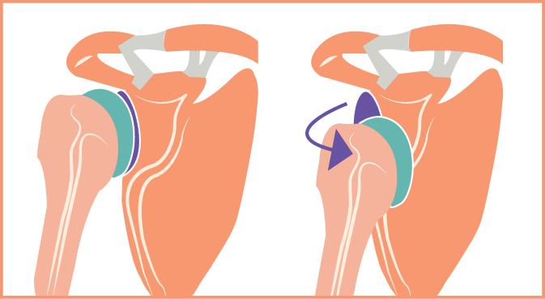
The Hemiplegic Arm and Hand
After Stroke
A low tone limb will feel limp and heavy.
A low tone hemiplegic arm is at risk of overstretching or tearing weakened muscles.
This may cause a partial dislocation (subluxation) which is not correctable.
Notes:
A low tone limb will feel limp and heavy. A low tone hemiplegic arm is at risk of overstretching or tearing weakened muscles. This may cause a partial dislocation (subluxation of the shoulder), which is not correctable.
Effects of a stroke can reduce the strength and tone of the muscles supporting the shallow shoulder joint.
As a result, gravity can drag the head of the humerus down, overstretching the weakened muscles.

Slide 6
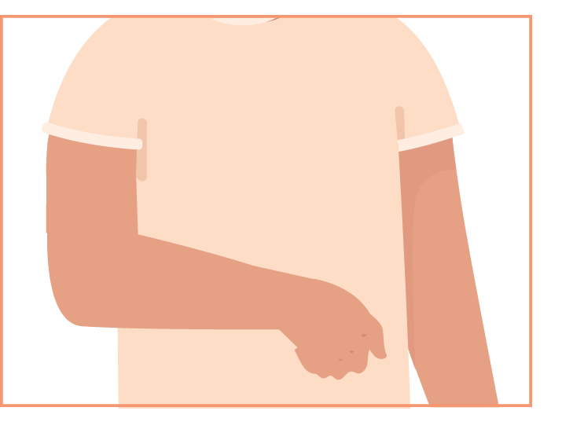
The Hemiplegic Arm and Hand
After Stroke
A high tone limb will feel stiff and tight. It can be very difficult to move the arm or hand, and to provide care.
This can contribute to:
Skin breakdown (underarm, hand)
Difficulty in assisting with hygiene and dressing
Limited range of motion (contractures)
Shoulder pain
Move the limb carefully and slowly - do not force movement!
Notes:
A high tone limb will feel stiff and tight. High muscle tone can pull the arm toward the chest wall, with a bent wrist and clenched hand. It can be very difficult to move the arm or hand, and to provide care. This can contribute to:
Skin breakdown (underarm, hand)
Difficulty in assisting with hygiene and dressing
Limited range of motion (contractures)
Shoulder pain
With high tone UE, move carefully, slowly, do not force movement. If care is becoming increasingly difficult, seek the advice of a therapist

Slide 7
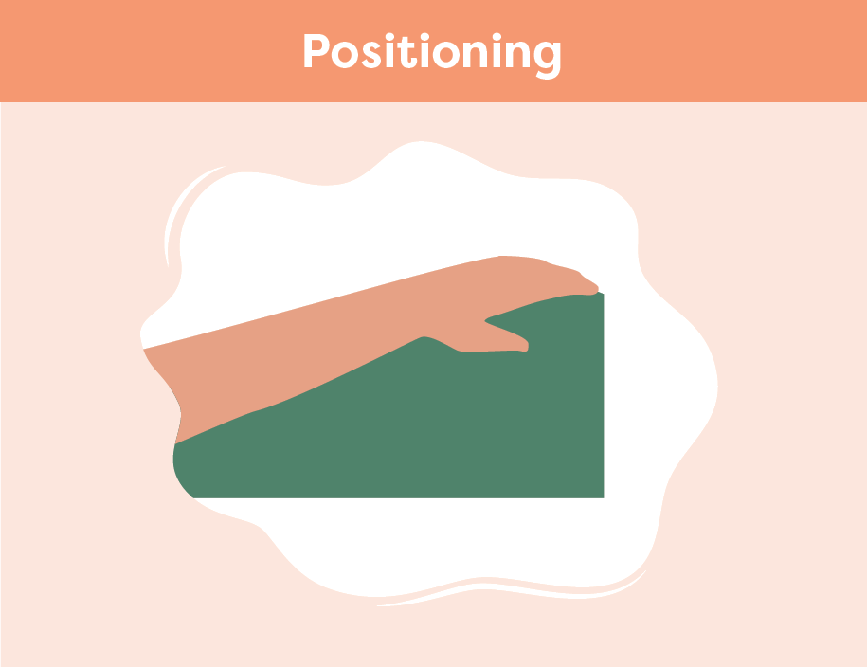
The Hemiplegic Arm and Hand
After Stroke
Smart Tips:
Be gentle when moving the arm or hand. Avoid pulling on the limb
Ensure the affected arm and hand are always supported. Try to:
ensure the elbow and forearm are placed away from the body
keep the wrist straight or slightly extended
place the hand palm down with fingers open as much as possible
Notes:
Smart Tips – Always follow the care plan!
These strategies pertain to positioning of the hemiplegic arm:
Be gentle when moving the arm or hand. Avoid pulling on the limb
Ensure the affected arm and hand are always supported using pillows or other equipment when recommended in the care plan
In every position, ensure the elbow and forearm are placed away from the body. Keep the wrist straight or slightly extended and place the hand palm down with fingers open as much as possible
See Smart Tips for Positioning in Chair/Wheelchair After Stroke and Positioning in Bed After Stroke

Slide 8
The Hemiplegic Arm and Hand
After Stroke
Goal: 30 degrees of wrist extension, 30 degrees of flexion through digits
Consider use of splints/ rolls
Careful positioning can help with reducing the high tone (spasticity), and maintain joint ROM
Notes:
This slide is optional- offers additional information pertaining to previous slide
Smart Tips – Always follow the care plan!
The goal is to maintain 30 degrees of wrist extension, 30 degrees of flexion through digits, consider use of splints/ rolls to maintain this position
Careful positioning can help with reducing the high tone (spasticity), and maintain joint ROM
It is important to consider the position and alignment of all the joints of the UE when looking at any one joint that is limited
See Smart Tips for Positioning in Chair/Wheelchair After Stroke and Positioning in Bed After Stroke

Slide 9
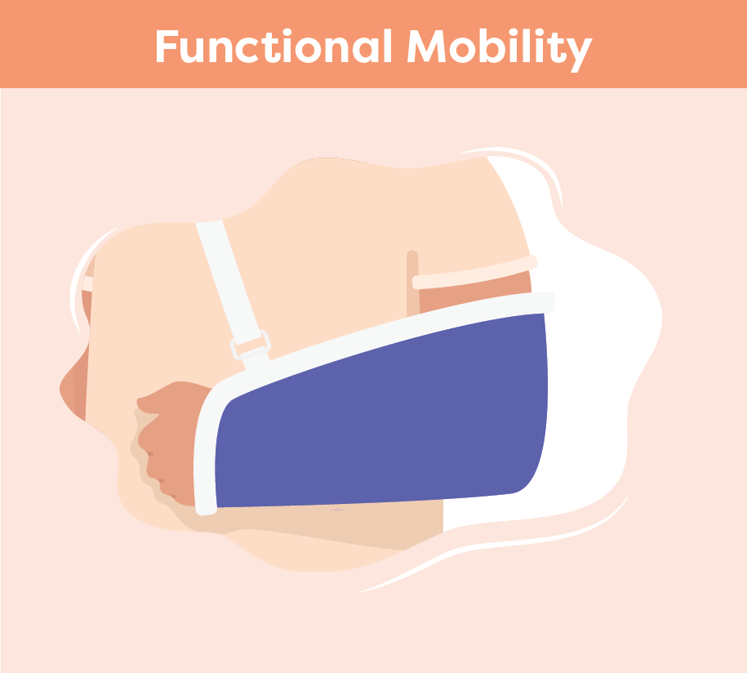
The Hemiplegic Arm and Hand
After Stroke
Never pull on the person’s affected arm or lift from the underarm
Encourage participation
When using a lifting device, ensure the affected arm is positioned inside the lift sling and in front of the body
Support the arm when the person is standing, transferring or ambulating
Use a sling if recommended by a therapist
Notes:
These strategies pertain to supporting the hemiplegic arm during functional mobility
Never pull on the person’s affected arm or lift from the underarm. Encourage the person to participate as much as they safely can. (See Smart Tips for Stroke Care - Mobility after Stroke and Transfers after Stroke)
When using a lifting device (e.g. floor lift, ceiling lift) ensure the affected arm is positioned inside the lift sling, and supported in front of the body
Ensure the arm is supported when the person is standing, transferring or ambulating
If recommended by a therapist, apply an arm sling to support the weight of their hemiplegic arm during mobility activities

Slide 10
The Hemiplegic Arm and Hand
After Stroke
Always support the hemiplegic arm
Move the arm and hand slowly and gently
Monitor clenched hand for hygiene and skin health
Do not raise the arm above shoulder level unless the person can do so themselves
Dressing rule for stroke: hemiplegic arm should be “first on; last off”
Notes:
These strategies pertain to activities of daily living (ADL’s)
Be careful to always support the hemiplegic arm
Move the arm and hand slowly and gently. This is especially important during tasks like bathing and dressing
Monitor persons with high tone that have a clenched hand for hygiene and skin health.
Look for finger nails digging in the palm (may need trimming), and cleanliness between the fingers
Do not raise the arm above shoulder level unless the person can do so themselves. If asked “Why not”?
Shoulder movement is complex and involves more than just the shoulder joint
The scapula (shoulder blade) has to move for the arm to move, especially as you move beyond 90 degrees of abduction and flexion. So, if the scapula is stuck (against the bed, high tone) and you move too far, you can cause injury
Never do exercises with the UE unless recommended by a therapist.
Dressing rule for stroke: hemiplegic arm should be “first on; last off”

Slide 11
The Hemiplegic Arm and Hand
After Stroke
Seek extra support
All team members have a role to play in caring for the affected arm and hand
Occupational Therapists and Physiotherapists are skilled in hemiplegia
Smart Tips for Stroke Care (2023) was created by members of the Regional Stroke Networks of Ontario. This material may be shared without permission from the authors, without changes and with source credited.
Notes:
All team members have a role to play in caring for the affected arm and hand
Occupational Therapists and Physiotherapists are experts in hemiplegia. It may be helpful to involve them in the person’s care

